Slide 1
Ch 5: CPU - Datapath and Control
中央处理器：数据通路和控制器
第一讲 单周期数据通路的设计
第二讲 单周期控制器的设计
第三讲 微程序控制原理与异常处理
Notes:
Start X:40

Slide 2
第一讲 单周期数据通路的设计
主 要 内 容
CPU的功能及其与计算机性能的关系
数据通路的位置
单周期数据通路的设计
  数据通路的功能和实现
    操作元件（组合逻辑部件）
    状态 / 存储元件（时序逻辑部件）
  数据通路的定时
选择MIPS指令集的一个子集作为CPU的实现目标
  下条指令地址计算与取指令部件
  R型指令的数据通路
  访存指令的数据通路
  立即数运算指令的数据通路
  分支和跳转指令的数据通路
综合所有指令的数据通路

Slide 3
CPU功能及其与计算机性能的关系
CPU执行指令的过程（回顾）
    取指令
    PC+“1”送PC
    指令译码
    进行主存地址运算
    取操作数
    进行算术 / 逻辑运算
    存结果
    以上每步都需检测“异常”，若有则
    自动切换到异常处理程序
    检测是否有“中断”请求，有则转中断处理
CPU的实现与计算机性能的关系
  计算机性能(程序执行快慢)由三个关键因素决定（回顾）
    指令数目、CPI、时钟周期
      指令数目由编译器和ISA决定
      时钟周期和CPI由CPU的实现以及其他因素来决定
取指阶段
指令执行过程
译码和
执行阶段
因此，CPU的设计与实现非常重要！它直接影响计算机的性能。

Slide 4
组成指令功能的四种基本操作
每条指令的功能总是由以下四种基本操作来实现：
  读取某一主存单元的内容，并将其装入某个寄存器（取指， 取数）
  把一个数据从某个寄存器存入给定的主存单元中（存结果）
  把一个数据从某个寄存器送到另一个寄存器或者ALU（取数，存结果）
  进行算术或逻辑运算（PC+1，计算地址，运算）
操作功能的形式化描述
  描述语言称为寄存器传送语言RTL (Register Transfer Language)
  本章所用的RTL规定如下：
    （1）用R[r]表示寄存器r的内容；
    （2）用M[addr]表示主存单元addr的内容；
    （3）传送方向用“←”表示，传送源在右，传送目的在左；
    （4）对于程序计数器PC，直接用PC表示其内容。
    例如，R[$8] ← M[R[$9]+4]的含义是：
    将寄存器$9的内容加4得到的内存地址中的内容送寄存器$8中。

Slide 5
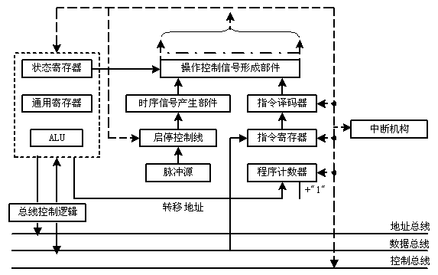
CPU基本组成原理图
指令寄存器----IR
程序计数器---PC
控制部件
执行部件
控制器 主要由 指令译码器 和 控制信号形成部件 组成
CPU 由 执行部件 和 控制部件组成
CPU 包含 数据通路(执行部件) 和 控制器（控制部件）

Slide 6
数据通路在计算机组成结构中的位置
计算机的五大组成部分：
什么是数据通路（DataPath）?
  指令执行过程中，数据所经过的路径，以及路径中的部件。它是指令的执行部件。
控制器（Control）的功能是什么？
  对指令进行译码，生成指令对应的控制信号，控制数据通路的动作。能对执行部件发出控制信号，是指令的控制部件。
Processor
Memory
Input
Control
Enable?
Read/Write
Program
Datapath
Address
PC
Bytes
Write Data
Registers
Arithmetic & Logic Unit
(ALU)
Data
ReadData
Output
Notes:
Before we go any further, let’s step back for a second and take a look at the big picture.
All computer consist of five components: (1) Input and (2) output devices. (3) The Memory System. And the (4) Control and (5) Datapath of the Processor.
Today’s lecture covers the datapath design.
In the next lecture, I will show you how to design the processor’s control unit.
+1 = 5 min. (X:45)

Slide 7
数据通路的基本结构
数据通路由两类元件组成
  组合逻辑元件（也称操作元件）
  时序逻辑元件（也称状态元件，存储元件）
元件间的连接方式
  总线连接方式
  分散连接方式
数据通路如何构成？
  由“操作元件”和“存储元件”通过总线方式或分散方式连接而成
数据通路的功能是什么？
  进行数据传送、处理和存储
搬数据
数据运算
存数据
数据通路功能示意图
因此，数据通路是由操作元件和存储元件通过总线方式或分散方式连接而成的进行数据传送、处理和存储的路径。

Slide 8
操作元件：组合逻辑电路
控制信号
CarryIn
译码器(Decoder)
A
加法器(Adder)
多路选择器 (MUX)
算逻部件(ALU)
out0
32
Adder
Sum
out1
32
out2
B
Carry
3
Decoder
32
加法器需要什么控制信号?
out7
Select
A
何时要用到adder, ALU, MUX or Decoder?
32
MUX
Y
32
B
32
组合逻辑元件的特点：
其输出只取决于当前的输入。即：若输入一样，则其输出也一样
无定时：所有输入到达后，经过一定的逻辑门延时，输出端改变，并保持到下次改变，不需要时钟信号来定时
ALUctr
A
32
ALU
Result
32
B
Zero
Back
32
Notes:
Based on the Register Transfer Language examples we have so far, we know we will need the following combinational logic elements.
We will need an adder to update the program counter.
A MUX to select the results.
And finally, an ALU to do various arithmetic and logic operation.
+1 = 30 min. (Y:10)

Slide 9
操作元件：组合逻辑电路（举例）
Select
Select
0
M
A
32
MUX
Y
U
32
B
1
X
32
Select
Select 分别
需要几位？
Select
0
A
0
1
32
M
B
…….
1
U
32
MUX
Y
X
C
30
2
32
32
31
D
3
32

Slide 10
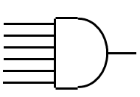


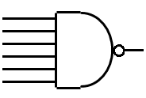


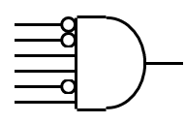
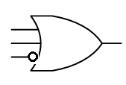
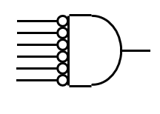
操作元件：组合逻辑电路

Slide 11
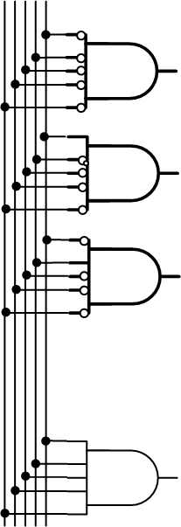

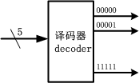
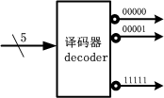
操作元件：组合逻辑电路(举例)
根据控制信号的数量，决定需要
多少位的输入。如果2,4,5,6位输入，
分别输出多少路控制信号？

Slide 12
状态元件：时序逻辑电路
状态元件（存储元件）的特点：
  具有存储功能，在时钟控制下输入被写到电路中，直到下个时钟到达
  输入端状态由时钟决定何时被写入，输出端状态随时可以读出
定时方式：规定信号何时写入状态元件或何时从状态元件读出
  边沿触发（edge-triggered）方式：
    状态单元中的值只在时钟边沿改变。每个时钟周期改变一次。
      上升沿（rising edge） 触发：在时钟正跳变时进行读/写。
      下降沿（falling edge）触发：在时钟负跳变时进行读/写。
最简单的状态单元（回顾：数字逻辑电路课程内容）：
  D触发器：一个时钟输入、一个状态输入、一个状态输出
falling edge
cycle time
rising edge
Back

Slide 13
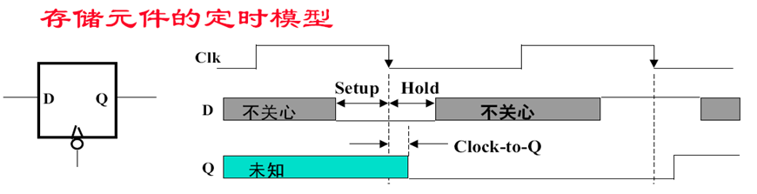

存储元件中何时状态被改变？
这期间D的变化不影响Q
1
0
0
1
Q总是在clock-to-Q后跟着D变化
( Latch Prop - 锁存延迟 )
Tmin>tsetup+thold
fmax<1/(tsetup+thold)
切记：状态单元的输入信息总是在一个时钟边沿到达后的“Clk-to-Q”时才被写入到单元中，此时的输出才反映新的状态值
1个或者多个触发器组成寄存器，32个触发器可以构成1个32位的寄存器
数据通路中的状态元件有两种：寄存器(组) + 存储器

Slide 14
存储元件: 寄存器和寄存器组
寄存器（Register）
  有一个写使能（Write Enable-WE）信号
  WE=0: 时钟边沿到来时，输出不变
  WE=1: 时钟边沿到来时，输出变为输入
  若每个时钟边沿都写入，则不需WE信号
寄存器组（Register File）：32个寄存器
  两个读口（组合逻辑操作）：busA和busB分别由RA和RB给出地址。地址RA或RB有效后，经一个“取数时间(AccessTime)”，busA和busB有效。
  一个写口（时序逻辑操作）：写使能为1的情况下，时钟边沿到来时，busW上的值开始被写入RW指定的寄存器中。
Write Enable
Data In
Data Out
N
N
Clk
Write Enable
RW
RA
RB
5
5
5
busA
busW
32
32 32-bit
Registers
32
busB
Clk
32
Notes:
As far as storage elements are concerned, we will need a N-bit register that is similar to the D flip-flop I showed you in class.
The significant difference here is that the register will have a Write Enable input.
That is the content of the register will NOT be updated if Write Enable is zero.
The content is updated at the clock tick ONLY if the Write Enable signal is set to 1.
+1 = 31 min. (Y:11)
Complement:
To know more detailed diagram for a register, see page B22-B25.

Slide 15
寄存器组的内部结构
Write Enable
RA
RB
5
5
Register 0
0
C
RW
32-to-1
Decoder
D
Register 1
5
C
M
D
busA
31
U
32
C
Register 30
X
D
C
Register 31
busW
D
32
Clk
M
每个寄存器由32个触发器组成;
输入数据来自busW，读出数据分别送busA和busB;
WriteEnable信号控制是否写入新值。
busB
U
32
X
Back to add

Slide 16
存储元件: 理想存储器
Address
Write Enable
理想存储器（ idealized memory ）
  Data Out：32位读出数据
  Data In： 32位写入数据
  Address：读写共用一个32位地址
  读操作（组合逻辑操作）：
    地址Address有效后，经一个“取数时间AccessTime”，Data Out上数据有效。
  写操作（时序逻辑操作） ：
    写使能为1的情况下，时钟Clk边沿到来时，Data In传来的值开始被写入Address指定的存储单元中。
Data In
DataOut
32
32
Clk
为简化数据通路操作说明，把存储器简化为带时钟信号Clk的理想模型。
Notes:
The last storage element you will need for the datapath is the idealized memory to store your data and instructions.
This idealized memory block has just one input bus (DataIn) and one output bus (DataOut).
When Write Enable is 0, the address selects the memory word to put on the Data Out bus.
When Write Enable is 1, the address selects the memory word to be written via the DataIn bus at the next clock tick.
Once again, the clock input is a factor ONLY during the write operation.
During read operation, it behaves as a combinational logic block.
That is if you put a valid value on the address lines, the output bus DataOut will become valid after the access time of the memory.
+2 = 35 min. (Y:15)

Slide 17
数据通路与时序控制
同步系统(Synchronous system)
  所有动作有专门时序信号来定时
  由时序信号规定何时发出什么动作
  例如，指令执行过程每一步都有控制信号控制，由定时信号确定控制信号何时发出、作用时间多长
什么是时序信号？
  同步系统中用于进行同步控制的定时信号，如时钟信号
什么叫指令周期？
  读取并执行一条指令的时间
  每条指令的指令周期都一样吗？
早期计算机的三级时序系统
  机器周期 - 节拍 - 脉冲
  指令周期可分为取指令、读操作数、执行并写结果等多个基本工作周期，称为机器周期。
  机器周期有取指令、存储器读、存储器写、中断响应等不同类型

Slide 18
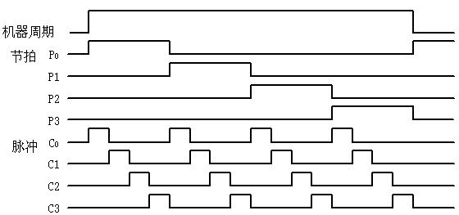
数据通路与时序控制 早期计算机的三级时序
现代计算机已不再采用三级时序系统，机器周期的概念已逐渐消失。
整个数据通路中的定时信号就是时钟，一个时钟周期就是一个节拍。

Slide 19
数据通路与时序控制
现代计算机的时钟周期
Clk
Setup
Hold
Setup
Hold
寄存器的输入可变化
.
.
.
.
.
.
.
.
.
.
.
.
Clk
Clk
数据通路由 “ … + 状态元件 + 操作元件( 组合电路) + 状态元件 + …” 组成
只有状态元件能存储信息，所有操作元件都须从状态单元接收输入，并将输出写入状态单元中。其输入为前一时钟生成的数据，输出为当前时钟所用的数据
假定采用下降沿触发（负跳变）方式（也可以是上升沿方式）
  所有状态单元在下降沿写入信息，经过锁存延时(clk-to-Q) 后输出有效
  时钟周期= Latch Prop + Longest Delay Path + Setup + Clock Skew(时钟偏移)
约束条件：(Latch Prop + Shortest Delay Path - Clock Skew) > Hold Time
即：操作元件输出有效信号出现的时间应该在下一级状态元件的输入保持时间之后。
Notes:
Remember, we will be using a clocking methodology where all storage elements are clocked by the same clock edge.
Consequently, our cycle time will be the sum of:
(a) The Clock-to-Q ( or latch propagation) time of the input registers.
(b) The longest delay path through the combinational logic block.
(c) The set up time of the output register.
(d) And finally the clock skew.
In order to avoid hold time violation, you have to make sure this inequality is fulfilled.
+2 = 18 min. (X:58)
Complements:
Why use edge-triggerd clocking methodology? simpler to explain in contrast to level-triggered.
Clock skew: difference in absolute time between the times when two state elements see a clock edge. It arises because the clock signal often follows different paths, with slightly delays, to reach two different state elements. Clock skew may cause a forward race of new inputs to the next flip-flop, leading to incorrect operation. (see Fig.B.31 at page B-41).
Clock-to-Q(or latch propagation): the propagation time of signal through a flip-flop from clock to the output Q. That is why it is called clock to Q time.
Setup time/hold time of flip-flop: the minimum time during which the input must be valid( or stable) before/after the clock edge.(page B-24)
(Latch Prop + Shortest Delay Path - Clock Skew) > Hold Time : this might be difficult to explain, but otherwise it will cause the race problem as shown in Fig.B.31.

Slide 20
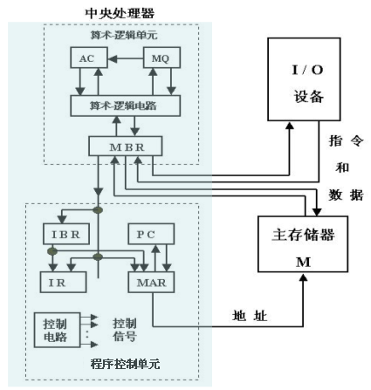
早期累加器型指令系统数据通路
AC：累加器
MQ：乘商寄存器
PC、IR、ALU、IBR、MBR：？
最简单的数据通路结构
取指令数据路径为：
PC→MAR,
Read M,
M→MBR→IBR→IR
取操作数、运算、送结果的数据路径为：
操作数地址→MAR,
Read M,
M→MBR→ALU输入端,
AC→ALU输入端,
ALU操作,
ALU结果→AC，
AC → MBR,
Write M
分散连接方式！
IAS计算机（冯.诺依曼结构）是现代计算机的原型

Slide 21
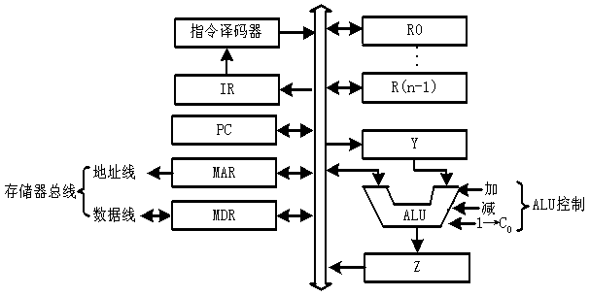
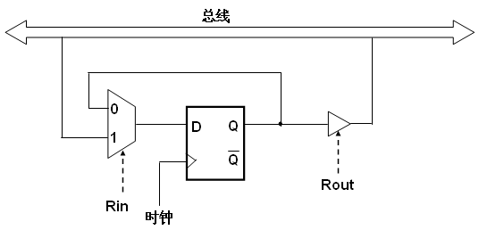
单总线数据通路
总线连接方式！
通用寄存器
四种基本操作的时序
  在寄存器之间传送数据
    R0out，Yin
  完成算术、逻辑运算
    R1out，Yin
    R2out，Add，Zin
    Zout，R3in
  从主存取字
    R1out，MARin
    Read, WMFC (等待MFC)
    MDRout，R2in
  写字到主存
    R1out，MARin
    R2out，MDRin，
    Write, WMFC
Y←R[R0]
1Cycle?
R[R3]←R[R1]+R[R2]
3Cycles?
外总线
R[R2]←M[R[R1]]
3Cycles?
内总线
Read/Write时间更长，故以此为准！
M[R[R1]] ← R[R2]
寄存器与总线的连接
3Cycles?
OP: Add、Sub、And、Or 等
CPU访存有两种通信方式
早期：直接访问MM, “异步”方式，用MFC（存储器完成）信号进行应答。
现在：先Cache后MM，“同步”方式，无需应答信号。
问题：时钟周期的宽度如何确定？
以“Riout,OP,Zin”所花时间来确定还是以 “Read/Write”所花时间来确定？ 以上四种操作各需要几个时钟周期？

Slide 22
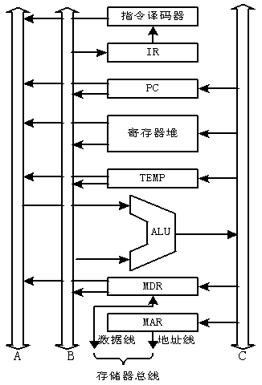
三总线数据通路
单总线中一个时钟内只允许传一个数据，因而指令执行效率很低
可采用多总线方式，同时在多个总线上传送不同数据，提高效率
例如：三总线数据通路
  总线A、B分别传送两个源操作数，总线C传送结果
  单总线中的暂存器Y和Z在此可取消，Why？
  采用双口通用寄存器组
  如何实现： R[R3] ←R[R1] op R[R2]
    R1outA，R2outB，op，R3inC
    只要一个时钟周期（节拍）即可！
通用寄存器组
Y
三个总线各自传不同数据，不会发生冲突，故无需Y和Z
Z
目前大都采用流水线方式执行指令，单总线或三总线的总线式数据通路很难实现指令流水执行。
下面以MIPS指令系统为例介绍非总线式CPU的设计。

Slide 23
单周期MIPS处理器的设计
复习：MIPS的三种指令类型
大家记得是哪三种类型？
R-Type、I-Type、J-Type
31
26
21
16
11
6
0
加法与减法
  add rd, rs, rt
  sub rd, rs, rt
OR Immediate:
  ori rt, rs, imm16
LOAD and STORE
  lw rt, rs, imm16
  sw rt, rs, imm16
BRANCH:
  beq rs, rt, imm16
JUMP:
  j target
op
rs
rt
rd
shamt
func
6 bits
5 bits
5 bits
5 bits
5 bits
6 bits
31
26
21
16
0
op
rs
rt
immediate
6 bits
5 bits
5 bits
16 bits
这些指令具有代表性！
有算术运算、逻辑运算；有RR型、RI型；有访存指令；有条件转移、无条件转移。
本讲目标：实现以上7条指令对应的数据通路！
教材中实现了11条指令，可将7条指令和11条指令的数据通路进行对比，以深入理解设计原理。
31
26
0
op
target address
6 bits
26 bits
Notes:
In today’s lecture, I will show you how to implement the following subset of MIPS instructions: add, subtract, or immediate, load, store, branch, and the jump instruction.
The Add and Subtract instructions use the R format. The Op together with the Func fields together specified all the different kinds of add and subtract instructions.
Rs and Rt specifies the source registers. And the Rd field specifies the destination register.
The Or immediate instruction uses the I format. It only uses one source register, Rs. The other operand comes from the immediate field. The Rt field is used to specified the destination register.
Both the load and store instructions use the I format and both add the Rs and the immediate filed together to form the memory address.
The difference is that the load instruction will load the data from memory into Rt while the store instruction will store the data in Rt into the memory.
The branch on equal instruction also uses the I format. Here Rs and Rt are used to specify the registers we need to compare.
If these two registers are equal, we will branch to a location specified by the immediate field.
Finally, the jump instruction uses the J format and always causes the program to jump to a memory location specified in the address field.
I know I went over this rather quickly and you may have missed something. But don’t worry, this is just an overview. You will keep seeing these (point to the format) all day today.
+3 = 13 min. (X:53)

Slide 24
设计处理器的步骤
ISA确定后，进行处理器设计的大致步骤如下：
第一步：分析每条指令的功能，并用RTL(Register Transfer Language)
来表示。
第二步：根据指令的功能给出所需的元件，并考虑如何将他们互连。
第三步：确定每个元件所需控制信号的取值。
第四步：汇总所有指令所涉及到的控制信号，生成一张反映指令与控制信 号之间关系的表。
第五步：根据表得到每个控制信号的逻辑表达式，据此设计控制器电路。
处理器设计涉及到数据通路的设计和控制器的设计
数据通路中有两种元件
  操作元件：由组合逻辑电路实现
  存储（状态）元件：由时序逻辑电路实现
Notes:
So let’s design a processor. How and where do we start?
Well, the best place to start is the processor’s instruction set architecture. After all, the goal of your design is to execute the instructions in the instruction set correctly.
What you need to do is to describe each instruction’s operation in register transfer language.
By looking at the Register Transfer Language description of the instruction, you can figure out the datapath components you need and how to connect these components together.
As I will show you, each datapath component will have its own set of control signals.
And the last step of the processor design task is to design the control unit that generates the control signals for the datapath.
So what do we mean by Register Transfer Language?
+2 = 27 min. (Y:07)

Slide 25
取指令公共操作及其部件(Instruction Fetch Unit)
每条指令都有的公共操作：
  取指令： M[PC]
  更新PC：PC ← PC + 4
  转移（Branch and Jump）时，PC内容要再次被更新为 “转移目标地址”
顺序：先取指令，再改PC的值（具体实现时，可以并行）
绝不能先改PC的值，再取指令
下地址逻辑
Clk
PC
Next Addr
Logic
取指后，各指令功能不同，数据通路中信息流动过程也不同
下面分别对每条指令进行相应数据通路的设计
Address
Instruction Word
Instruction
Memory
32
取指令部件
Notes:
Now let’s take a look at the first major component of the datapath: the instruction fetch unit.
The common RTL operations for all instructions are:
(a) Fetch the instruction using the Program Counter (PC) at the beginning of an
instruction’s execution (PC -> Instruction Memory -> Instruction Word).
(b) Then at the end of the instruction’s execution, you need to update the
Program Counter (PC -> Next Address Logic -> PC).
More specifically, you need to increment the PC by 4 if you are executing sequential code.
For Branch and Jump instructions, you need to update the program counter to “something else” other than plus 4.
I will show you what is inside this Next Address Logic block when we talked about the Branch and Jump instructions.
For now, let’s focus our attention to the Add and Subtract instructions.
+2 = 37 min. (Y:17)

Slide 26
加法和减法指令(R-type类型）
首先考虑add和sub指令（R-Type指令的代表）
实现目标（7条指令）：
ADD and subtract
  add rd, rs, rt
  sub rd, rs, rt
OR Immediate:
  ori rt, rs, imm16
LOAD and STORE
  lw rt, rs, imm16
  sw rt, rs, imm16
BRANCH:
  beq rs, rt, imm16
JUMP:
  j target
31
26
21
16
11
6
0
op
rs
rt
rd
shamt
func
6 bits
5 bits
5 bits
5 bits
5 bits
6 bits
31
26
21
16
0
op
rs
rt
immediate
6 bits
5 bits
5 bits
16 bits
31
26
0
op
target address
6 bits
26 bits
Notes:
In today’s lecture, I will show you how to implement the following subset of MIPS instructions: add, subtract, or immediate, load, store, branch, and the jump instruction.
The Add and Subtract instructions use the R format. The Op together with the Func fields together specified all the different kinds of add and subtract instructions.
Rs and Rt specifies the source registers. And the Rd field specifies the destination register.
The Or immediate instruction uses the I format. It only uses one source register, Rs. The other operand comes from the immediate field. The Rt field is used to specified the destination register.
Both the load and store instructions use the I format and both add the Rs and the immediate filed together to form the memory address.
The difference is that the load instruction will load the data from memory into Rt while the store instruction will store the data in Rt into the memory.
The branch on equal instruction also uses the I format. Here Rs and Rt are used to specify the registers we need to compare.
If these two registers are equal, we will branch to a location specified by the immediate field.
Finally, the jump instruction uses the J format and always causes the program to jump to a memory location specified in the address field.
I know I went over this rather quickly and you may have missed something. But don’t worry, this is just an overview. You will keep seeing these (point to the format) all day today.
+3 = 13 min. (X:53)

Slide 27
加法指令add的RTL描述
add rd, rs, rt
  M[PC]
  R[rd] ← R[rs] + R[rt]
  PC ← PC + 4 PC加4，使PC指向下一条指令
31
26
21
16
11
6
0
op
rs
rt
rd
shamt
func
6 bits
5 bits
5 bits
5 bits
5 bits
6 bits
从PC所指的内存单元中取指令
从rs、rt 所指的寄存器中取数后相加。
若结果不溢出，则将结果送rd 所指的寄存器中；
若结果溢出，则不送结果，并转到“溢出处理程序”执行。
Notes:
Here is an example. In terms of Register Transfer Language, this is what the Add instruction need to do.
First, you need to fetch the instruction from memory.
Then you perform the actual add operation.
And finally, you need to update the program counter to point to the next instruction.
+1 = 28 min. (Y:08)

Slide 28
RR（R-type）型指令的数据通路
31
26
21
16
11
6
0
op
rs
rt
rd
shamt
func
6 bits
5 bits
5 bits
5 bits
5 bits
6 bits
溢出时，不写结果并需转异常处理程序
功能：R[rd] ← R[rs] op R[rt]，如：add rd, rs, rt
不考虑公共操作，仅R-Type指令执行阶段的数据通路如下：
RegWr
rd
rs
rt
5
5
5
ALUctr
Write Enable
busA
寄存器组结构
Rw
Ra
Rb
busW
32
溢出
32 32-bit
Registers
Result
32
ALU
32
Clk
busB
32
  Ra, Rb, Rw 分别对应指令的rs, rt, rd
“add rd, rs, rt”控制信号有哪些？
ALUctr=add，RegWr=1
ALUctr,RegWr: 指令译码后产生的控制信号
跳到：带立即数的逻辑指令ori的RTL描述
Notes:
And here is the datapath that can do the trick.
First of all, we connect the register file’s Ra, Rb, and Rw input to the Rd, Rs, and Rt fields of the instruction bus (points to the format diagram).
Then we need to connect busA and busB of the register file to the ALU.
Finally, we need to connect the output of the ALU to the input bus of the register file.
Conceptually, this is how it works.
The instruction bus coming out of the Instruction memory will set the Ra and Rb to the register specifiers Rs and Rt.
This causes the register file to put the value of register Rs onto busA and the value of register Rt onto busB, respectively.
But setting the ALUctr appropriately, the ALU will perform either the Add and Subtract for us.
The result is then fed back to the register file where the register specifier Rw should already be set to the instruction bus’s Rd field.
Since the control, which we will design in our next lecture, should have already set the RegWr signal to 1, the result will be written back to the register file at the next clock tick (points to the Clk input).
+3 = 42 min. (Y:22)

Slide 29
带立即数的逻辑指令（ori指令）
作为I-Type指令和逻辑运算指令的代表
实现目标（7条指令）：
ADD and subtract
  add rd, rs, rt
  sub rd, rs, rt
OR Immediate:
  ori rt, rs, imm16
LOAD and STORE
  lw rt, rs, imm16
  sw rt, rs, imm16
BRANCH:
  beq rs, rt, imm16
JUMP:
  j target
31
26
21
16
11
6
0
op
rs
rt
rd
shamt
func
6 bits
5 bits
5 bits
5 bits
5 bits
6 bits
31
26
21
16
0
op
rs
rt
immediate
6 bits
5 bits
5 bits
16 bits
31
26
0
op
target address
6 bits
26 bits
Notes:
In today’s lecture, I will show you how to implement the following subset of MIPS instructions: add, subtract, or immediate, load, store, branch, and the jump instruction.
The Add and Subtract instructions use the R format. The Op together with the Func fields together specified all the different kinds of add and subtract instructions.
Rs and Rt specifies the source registers. And the Rd field specifies the destination register.
The Or immediate instruction uses the I format. It only uses one source register, Rs. The other operand comes from the immediate field. The Rt field is used to specified the destination register.
Both the load and store instructions use the I format and both add the Rs and the immediate filed together to form the memory address.
The difference is that the load instruction will load the data from memory into Rt while the store instruction will store the data in Rt into the memory.
The branch on equal instruction also uses the I format. Here Rs and Rt are used to specify the registers we need to compare.
If these two registers are equal, we will branch to a location specified by the immediate field.
Finally, the jump instruction uses the J format and always causes the program to jump to a memory location specified in the address field.
I know I went over this rather quickly and you may have missed something. But don’t worry, this is just an overview. You will keep seeing these (point to the format) all day today.
+3 = 13 min. (X:53)

Slide 30
带立即数的逻辑指令ori的RTL描述
31
26
21
16
0
op
rs
rt
imm16
6 bits
5 bits
5 bits
16 bits
逻辑运算，立即数为逻辑数
ori rt, rs, imm16
  M[PC] 取指令（公共操作，取指部件完成）
  R[rt] ← R[rs] or ZeroExt(imm16)
  立即数零扩展，并与rs内容做“或”运算
  PC ← PC + 4 计算下地址（公共操作，取指部件完成）
零扩展 ZeroExt(imm16)
31
16
15
0
0000 0000 0000 0000
imm16
16 bits
16 bits
思考：应在前面数据通路上加哪些元件和连线？用何控制信号？
回看：RR（R-type）型指令的数据通路
Notes:
The or immediate is a I-type instruction.
The immediate field of the instruction (Imm16 of the format diagram) is zero extended to 32 bits before it is operated with the other operand.
The other operand is selected by the Rs field of the instruction.
The destination register of this instruction will be selected by the Rt field.
+2 = 57 min. (Y:27)

Slide 31
带立即数的逻辑指令的数据通路
R[rt] ← R[rs] op ZeroExt[imm16]] Example: ori rt, rs, imm16
31
26
21
16
0
op
rs
rt
imm16
6 bits
5 bits
5 bits
16 bits
R-Type类型的结果写入Rd，ori指令是写入Rt
Rd
Rt
应增加兰色部分，为什么？
RegDst
0
1
Don’t Care
(Rt)
Mux
Rs
ALUctr
RegWr
5
5
5
busA
Rw
Ra
Rb
busW
32
Result
32 32-bit
Registers
32
ALU
32
busB
0
Clk
32
Mux
Ext
1
R-Type的操作数来自busB
imm16
32
16
ALUSrc
Ori指令的控制信号：RegDst=？；RegWr=？；ALUctr=？；ALUSrc=？
Ori指令的控制信号：RegDst=1；RegWr=1；ALUSrc=1；ALUctr=or
Notes:
Here is the datapath for the Or immediate instructions.
We cannot use the Rd field here (Rw) because in this instruction format, we don’t have a Rd field. The Rd field in the R-type is used here as part of the immediate field.
For this instruction type, Rw input of the register file, that is the address of the register to be written, comes from the Rt field of the instruction.
Recalled from earlier slide that for R-type instruction, the Rw comes from the Rd field.
That’s why we need a MUX here to put Rd onto Rw for R-type instructions and to put Rt onto Rw for the I-type instruction.
Since the second operation of this instruction will be the immediate field zero extended to 32 bits, we also need a MUX here to block off bus B from the register file.
Since bus B is blocked off by the MUX, the value on bus B is don’t care. Therefore we do not have to worry about what ends up on the register file’s Rb register specifier.
To keep things simple, we may just as well keep it the same as the R-type instruction and put the Rt field here.
So to summarize, this is how this datapath works. With Rs on Register File’s Ra input, bus A will get the value of Rs as the first ALU operand.
The second operand will come from the immediate field of the instruction.
Once the ALU complete the OR operation, the result will be written into the register specified by the instruction’s Rt field.
+3 = 50 min. (Y:30)

Slide 32
访存指令中的数据装入指令 (lw指令)
实现目标（7条指令）：
ADD and subtract
  add rd, rs, rt
  sub rd, rs, rt
OR Immediate:
  ori rt, rs, imm16
LOAD and STORE
  lw rt, rs, imm16
  sw rt, rs, imm16
BRANCH:
  beq rs, rt, imm16
JUMP:
  j target
31
26
21
16
11
6
0
op
rs
rt
rd
shamt
func
6 bits
5 bits
5 bits
5 bits
5 bits
6 bits
31
26
21
16
0
op
rs
rt
immediate
6 bits
5 bits
5 bits
16 bits
3. 考虑lw 指令（访存指令的代表）
31
26
0
op
target address
6 bits
26 bits
Notes:
In today’s lecture, I will show you how to implement the following subset of MIPS instructions: add, subtract, or immediate, load, store, branch, and the jump instruction.
The Add and Subtract instructions use the R format. The Op together with the Func fields together specified all the different kinds of add and subtract instructions.
Rs and Rt specifies the source registers. And the Rd field specifies the destination register.
The Or immediate instruction uses the I format. It only uses one source register, Rs. The other operand comes from the immediate field. The Rt field is used to specified the destination register.
Both the load and store instructions use the I format and both add the Rs and the immediate filed together to form the memory address.
The difference is that the load instruction will load the data from memory into Rt while the store instruction will store the data in Rt into the memory.
The branch on equal instruction also uses the I format. Here Rs and Rt are used to specify the registers we need to compare.
If these two registers are equal, we will branch to a location specified by the immediate field.
Finally, the jump instruction uses the J format and always causes the program to jump to a memory location specified in the address field.
I know I went over this rather quickly and you may have missed something. But don’t worry, this is just an overview. You will keep seeing these (point to the format) all day today.
+3 = 13 min. (X:53)

Slide 33
Lw指令的RTL描述
立即数用补码表示
31
26
21
16
0
op
rs
rt
immediate
6 bits
5 bits
5 bits
16 bits
lw rt, rs, imm16
  M[PC] 取指令（公共操作，取指部件完成）
  Addr ← R[rs] + SignExt(imm16) 计算存储单元地址 (符号扩展！)
  R[rt] ← M [Addr] 装入数据到寄存器rt中
  PC ← PC + 4 计算下地址（公共操作，取指部件完成）
符号扩展( 为什么不是零扩展? ) ：
31
16
15
0
0000 0000 00000 0000
0
immediate
31
16 bits
16
15
16 bits
0
1111 1111 1111 1111
1
immediate
16 bits
16 bits
思考：应在原数据通路上加哪些元件和连线？用何控制信号？
Notes:
Like the OR immediate instruction I just showed you, the load instruction also uses the I format (point to the format diagram).
But unlike the OR immediate instruction, the immediate field (Imm16 of the format diagram) is sign extended instead of zero extended.
That is we will duplicate the most significant bit of 16 times to the left to form a 32-bit value.
This sign extended value (SignExt) is then added to the register selected by the Rs field of the instruction to form the memory address.
The memory address is then used to load the value into the register specified by the Rt field of the instruction (Rt of the format diagram).
+2 = 57 min. (Y:37)

Slide 34
装入(lw)指令的数据通路
R[rt] ← M[ R[rs] + SignExt[imm16] ] lw rt, rs, imm16
31
26
21
16
0
op
rs
rt
imm16
6 bits
5 bits
5 bits
16 bits
Rd
Rt
RegDst
0
1
加兰色部分。为什么？
Mux
Don’t Care
(Rt)
Rs
ALUctr
RegWr
5
5
5
MemtoReg
busA
Rw
Ra
Rb
busW
32
32 32-bit
Registers
0
32
ALU
32
Mux
Clk
busB
0
32
32
1
Mux
WrEn
Adr
Ext
1
Data In
imm16
32
Data
Memory
16
32
Clk
ALUSrc
ExtOp
0:零扩展，1：符号扩展
控制信号RegDst, RegWr, ALUctr, ExtOp, ALUSrc, MemtoReg 各取何值？
RegDst=1, RegWr=1, ALUctr=addu, ExtOp=1, ALUSrc=1, MemtoReg=1
Notes:
Once again we cannot use the instruction’s Rd field for the Register File’s Rw input because load is a I-type instruction and there is no such thing as the Rd field in the I format.
So instead of Rd, the Rt field is used to specify the destination register through this two to one multiplexor.
The first operand of the ALU comes from busA of the register file which contains the value of Register Rs (points to the Ra input of the register file).
The second operand, on the other hand, comes from the immediate field of the instruction.
Instead of using the Zero Extender I used in datapath for the or immediate datapath, I have to use a more general purpose Extender that can do both Sign Extend and Zero Extend.
The ALU then adds these two operands together to form the memory address.
Consequently, the output of the ALU has to go to two places:
(a) First the address input of the data memory.
(b) And secondly, also to the input of this two-to-one multiplexer.
The other input of this multiplexer comes from the output of the data memory so we can place the output of the data memory onto the register file’s input bus for the load instruction.
For Add, Subtract, and the Or immediate instructions, the output of the ALU will be selected to be placed on the input bus of the register file.
In either case, the control signal RegWr should be asserted so the register file will be written at the end of the cycle.
+3 = 60 min. (Y:40)

Slide 35
访存指令中的存数指令 (sw)
实现目标（7条指令）：
ADD and subtract
  add rd, rs, rt
  sub rd, rs, rt
OR Immediate:
  ori rt, rs, imm16
LOAD and STORE
  lw rt, rs, imm16
  sw rt, rs, imm16
BRANCH:
  beq rs, rt, imm16
JUMP:
  j target
31
26
21
16
11
6
0
op
rs
rt
rd
shamt
func
6 bits
5 bits
5 bits
5 bits
5 bits
6 bits
31
26
21
16
0
op
rs
rt
immediate
6 bits
5 bits
5 bits
16 bits
4. 考虑sw 指令（访存指令的代表）
31
26
0
op
target address
6 bits
26 bits
Notes:
In today’s lecture, I will show you how to implement the following subset of MIPS instructions: add, subtract, or immediate, load, store, branch, and the jump instruction.
The Add and Subtract instructions use the R format. The Op together with the Func fields together specified all the different kinds of add and subtract instructions.
Rs and Rt specifies the source registers. And the Rd field specifies the destination register.
The Or immediate instruction uses the I format. It only uses one source register, Rs. The other operand comes from the immediate field. The Rt field is used to specified the destination register.
Both the load and store instructions use the I format and both add the Rs and the immediate filed together to form the memory address.
The difference is that the load instruction will load the data from memory into Rt while the store instruction will store the data in Rt into the memory.
The branch on equal instruction also uses the I format. Here Rs and Rt are used to specify the registers we need to compare.
If these two registers are equal, we will branch to a location specified by the immediate field.
Finally, the jump instruction uses the J format and always causes the program to jump to a memory location specified in the address field.
I know I went over this rather quickly and you may have missed something. But don’t worry, this is just an overview. You will keep seeing these (point to the format) all day today.
+3 = 13 min. (X:53)

Slide 36
存数指令sw的RTL描述
31
26
21
16
0
op
rs
rt
imm16
6 bits
5 bits
5 bits
16 bits
sw rt, rs, imm16
  M[PC] 取指令（公共操作，取指部件完成）
  Addr ← R[rs] + SignExt(imm16) 计算存储单元地址（符号扩展！）
  Mem[Addr] ← R[rt] 寄存器rt中的内容存到内存单元中
  PC ← PC + 4 计算下地址（公共操作，取指部件完成）
思考：应在原数据通路上加哪些元件和连线？用何控制信号？
Notes:
Just like the load instruction:
(a) The store instruction also uses the I format.
(b) And the store instruction also forms the memory address by adding the contents
of the register selected by the Rs field to the sign extended immediate field.
However, unlike the load instruction, which gets data from memory and put the data into the the register file, the store instruction:
(a) Get the register selected by the Rt field of the instruction (R[rt]).
(b) And then write this register into the data memory.
+2 = 62 min. (Y:42)

Slide 37
存数(sw)指令的数据通路
M[ R[rs] + SignExt[imm16] ← R[rt] ] Example: sw rt, rs, imm16
31
26
21
16
0
op
rs
rt
imm16
6 bits
5 bits
5 bits
16 bits
Rd
Rt
RegDst
0
1
加兰色部分。为什么？
Mux
Rs
Rt
ALUctr
RegWr
5
5
5
MemtoReg
busA
Rw
Ra
Rb
busW
32
32 32-bit
Registers
0
32
ALU
32
Clk
busB
MemWr
32
Mux
0
32
Mux
Data In
1
WrEn
Adr
Ext
1
32
imm16
32
Data
Memory
16
ALUSrc
Clk
ExtOp
控制信号RegDst, RegWr, ALUctr, ExtOp, ALUSrc, MemWr, MemtoReg 各取何值？
RegDst=x, RegWr=0, ALUctr=addu, ExtOp=1, ALUSrc=1, MemWr=1, MemtoReg=x
Notes:
And here is the datapath for the store instruction.
The Register File, the ALU, and the Extender are the same as the datapath for the load instruction because the memory address has to be calculated the exact same way:
(a) Put the register selected by Rs onto bus A and sign extend the 16 bit immediate field.
(b) Then make the ALU (ALUctr) adds these two (busA and output of Extender) together.
The new thing we added here is busB extension (DataIn).
More specifically, in order to send the register selected by the Rt field (Rb of the register file) to data memory, we need to connect bus B to the data memory’s Data In bus.
Finally, the store instruction is the first instruction we encountered that does not do any register write at the end.
Therefore the control unit must make sure RegWr is zero for this instruction.
+2 = 64 min. (Y:44)

Slide 38
分支（条件转移）指令（相等转移：beq）
实现目标（7条指令）：
ADD and subtract
  add rd, rs, rt
  sub rd, rs, rt
OR Immediate:
  ori rt, rs, imm16
LOAD and STORE
  lw rt, rs, imm16
  sw rt, rs, imm16
BRANCH:
  beq rs, rt, imm16
JUMP:
  j target
31
26
21
16
11
6
0
op
rs
rt
rd
shamt
func
6 bits
5 bits
5 bits
5 bits
5 bits
6 bits
31
26
21
16
0
op
rs
rt
immediate
6 bits
5 bits
5 bits
16 bits
5. 考虑beq指令（条件转移指令的代表）
31
26
0
op
target address
6 bits
26 bits
Notes:
In today’s lecture, I will show you how to implement the following subset of MIPS instructions: add, subtract, or immediate, load, store, branch, and the jump instruction.
The Add and Subtract instructions use the R format. The Op together with the Func fields together specified all the different kinds of add and subtract instructions.
Rs and Rt specifies the source registers. And the Rd field specifies the destination register.
The Or immediate instruction uses the I format. It only uses one source register, Rs. The other operand comes from the immediate field. The Rt field is used to specified the destination register.
Both the load and store instructions use the I format and both add the Rs and the immediate filed together to form the memory address.
The difference is that the load instruction will load the data from memory into Rt while the store instruction will store the data in Rt into the memory.
The branch on equal instruction also uses the I format. Here Rs and Rt are used to specify the registers we need to compare.
If these two registers are equal, we will branch to a location specified by the immediate field.
Finally, the jump instruction uses the J format and always causes the program to jump to a memory location specified in the address field.
I know I went over this rather quickly and you may have missed something. But don’t worry, this is just an overview. You will keep seeing these (point to the format) all day today.
+3 = 13 min. (X:53)

Slide 39
RTL: The Branch Instruction
立即数用补码表示
31
26
21
16
0
op
rs
rt
imm16
6 bits
5 bits
5 bits
16 bits
beq rs, rt, imm16
  M[PC] 取指令（公共操作，取指部件完成）
  Cond ← R[rs] - R[rt] 做减法比较rs和rt中的内容
  if (COND eq 0) 计算下地址（根据比较结果，修改PC）
    PC ← PC + 4 + ( SignExt(imm16) x 4 )
  else
    PC ← PC + 4
思考：立即数的含义是什么？是相对指令数还是相对单元数？
应在原数据通路上加哪些元件和连线？用什么控制信号来控制？
Notes:
How does the branch on equal instruction work?
Well it calculates the branch condition by subtracting the register selected by the Rt field from the register selected by the Rs field.
If the result of the subtraction is zero, then these two registers are equal and we take a branch. Otherwise, we keep going down the sequential path (PC <- PC +4).
+1 = 65 min. (Y:45)

Slide 40
条件转移指令的数据通路
beq rs, rt, imm16 We need to compare Rs and Rt !
31
26
21
16
0
op
rs
rt
imm16
6 bits
5 bits
5 bits
16 bits
Rd
Rt
Branch
Clk
RegDst
PC
0
1
Mux
Rs
Rt
ALUctr
imm16
RegWr
5
5
5
Next Addr
Logic
busA
16
Rw
Ra
Rb
busW
32
32 32-bit
Registers
ALU
32
Clk
busB
0
Zero
To Instruction
Memory
32
Mux
1
imm16
Ext
32
思考：下址逻辑如何设计？
16
ExtOp
ALUSrc
RegDst, RegWr, ALUctr, ExtOp, ALUSrc, MemWr, MemtoReg, Branch 各取何值？
RegDst=x, RegWr=0, ALUctr=subu, ExtOp=x, ALUSrc=0, MemWr=0, MemtoReg=x, Branch=1
Notes:
The datapath for calculating the branch condition is rather simple.
All we have to do is feed the Rs and Rt fields of the instruction into the Ra and Rb inputs of the register file.
Bus A will then contain the value from the register selected by Rs.
And bus B will contain the value from the register selected by Rt.
The next thing to do is to ask the ALU to perform a subtract operation and feed the output Zero to the next address logic.
How does the next address logic block look like?
Well, before I show you that, let’s take a look at the binary arithmetics behind the program counter (PC).
+2 = 67 min. (Y:47)

Slide 41
下地址计算逻辑的设计
PC是一个32位地址:
  顺序执行时: PC<31:0> = PC<31:0> + 4
  转移执行时: PC<31:0> = PC<31:0> + 4 + SignExt[Imm16] X 4
实现时需要做两次加法，用两个加法器完成，“X4”操作用左移2位实现。为了简化运算可以采用以下措施：
MIPS是按字节编址，每条指令为32位，占4个字节，故PC的值总是4的倍数，即后两位为00，去除这2位，PC只需要30位即可。
PC采用30位后，其转移地址计算逻辑变得更加简单。
下地址计算逻辑简化为：
顺序执行时: PC<31:2> = PC<31:2> + 1
  转移执行时: PC<31:2> = PC<31:2> + 1 + SignExt[Imm16]
  取指令时: 指令地址 = PC<31:2> 串接 “00”
扩展成30位
Notes:
In theory, the Program Counter (PC) is a 32-bit byte address into the Instruction memory.
The Program Counter is increment by four after each sequential instruction.
When a branch is taken, we need to sign extend the 16 bit immediate field, multiply this sign extended value by four, and add it to the sequential instruction address (PC + 4).
Why does this magic number “4” always come up? Well the reason is that the 32-bit PC is a byte address and all MIPS instructions are four bytes, or 32 bits, long.
In other words, if we keep a 32-bit Program Counter, then the two least significant bits of the Program Counter will always be zeros.
And if these two bits are always zeros, there is no reason to have hardware to keep them.
So in practice, we will simply the hardware by using a 30 bit program counter.
That is, we will build a Program Counter that only keep tracks of the upper 30 bits (<31:2>) of the instruction address because we know the 2 least significant bits will always be 0s.
Then instead of always increase the Program Counter by four for sequential operation, we only have to increase it by 1.
And for branch operation, we don’t need to multiply the sign extended immediate field by four before adding to the sequential PC (PC + 1).
And when we apply the program counter to the address of the instruction memory, we need to attach two zeros to its least significant bits.
+3 = 70 min. (Y:50)

Slide 42
下地址逻辑设计
用30-bit PC:
  顺序执行时: PC<31:2> = PC<31:2> + 1
  转移执行时: PC<31:2> = PC<31:2> + 1 + SignExt[Imm16]
  取指令时: 指令地址 = PC<31:2> 串接 “00”
30
Addr<31:2>
30
Addr<1:0>
PC
“00”
30
Adder
0
Instruction
Memory
30
Mux
“1”
Adder
1
32
Clk
30
imm16
30
16
SignExt
Instruction<31:0>
Instruction<15:0>
Branch
Zero
标志位ZF，由ALU产生！
先根据当前PC取指令， 计算的下条指令地址在下一个时钟到来后才能写入PC！
为什么这里没有用“ALU”而是用“Adder”? “ALU”和“Adder”有什么差别？
Notes:
So let’s see how we can put all these theories (point to the equations) into practice.
The PC plus one is implemented by this first adder here.
For branch operation, we need to sign extend the immediate field of the instruction and then add it to the output of the first adder to implement this equation (PC + 1 + SignExt(imm16)).
For sequential operation, the output of the first adder is selected by the two-to-one mux so it will be saved into the PC register at the next clock tick.
For a taken branch, that is we have a branch_on_equal and the condition Zero is true, the output of the second adder is selected.
In all cases, the 30 bit Program Counter is used as instruction address bit 31 to bit 2.
The two least significant bits of the instruction address will always be zeroes.
One question you may want to ask is: Do we really need an adder just to add “1”?
Well may be not.
+2 = 72 min. (Y:52)

Slide 43
无条件转移指令
实现目标（7条指令）：
ADD and subtract
  add rd, rs, rt
  sub rd, rs, rt
OR Immediate:
  ori rt, rs, imm16
LOAD and STORE
  lw rt, rs, imm16
  sw rt, rs, imm16
BRANCH:
  beq rs, rt, imm16
JUMP:
  j target
31
26
21
16
11
6
0
op
rs
rt
rd
shamt
func
6 bits
5 bits
5 bits
5 bits
5 bits
6 bits
31
26
21
16
0
op
rs
rt
immediate
6 bits
5 bits
5 bits
16 bits
6. 考虑Jump指令（无条件转移指令的代表）
31
26
0
op
target address
6 bits
26 bits
Notes:
In today’s lecture, I will show you how to implement the following subset of MIPS instructions: add, subtract, or immediate, load, store, branch, and the jump instruction.
The Add and Subtract instructions use the R format. The Op together with the Func fields together specified all the different kinds of add and subtract instructions.
Rs and Rt specifies the source registers. And the Rd field specifies the destination register.
The Or immediate instruction uses the I format. It only uses one source register, Rs. The other operand comes from the immediate field. The Rt field is used to specified the destination register.
Both the load and store instructions use the I format and both add the Rs and the immediate filed together to form the memory address.
The difference is that the load instruction will load the data from memory into Rt while the store instruction will store the data in Rt into the memory.
The branch on equal instruction also uses the I format. Here Rs and Rt are used to specify the registers we need to compare.
If these two registers are equal, we will branch to a location specified by the immediate field.
Finally, the jump instruction uses the J format and always causes the program to jump to a memory location specified in the address field.
I know I went over this rather quickly and you may have missed something. But don’t worry, this is just an overview. You will keep seeing these (point to the format) all day today.
+3 = 13 min. (X:53)

Slide 44
无条件转移指令的RTL描述
31
26
0
op
target address
6 bits
26 bits
j target
  M[PC] 取指令（公共操作，取指部件完成）
  PC<31:2> ← PC<31:28> 串接 target<25:0> 计算目标地址
FFFF FFFF
F000 0000
EFFF FFFF
E000 0000
AFFF FFFF
A000 0000
0FFF FFFF
0000 0000
想一想：跳转指令的转移范围有多大？
是当前指令后面的0x000 0000~0xFFF FFFC 处？
不对！它不是相对寻址，而是绝对寻址，但其转移范围只能在j指令所在的2²⁸=256MB页面内，页面号与j指令相同PC<31:28>。
j target
思考：应在原数据通路上加哪些元件和连线？用什么控制信号来控制？
Notes:
Finally, let’s take a look at the jump instruction which uses the J format.
The effect of the jump instruction is to change the lower 26 bits of the Program Counter to the value specified in the address field of the instruction.
+1 = 76 min. (Y:46)

Slide 45
Instruction Fetch Unit: 取指令部件
j target
  PC<31:2> ← PC<31:28> concat target<25:0>
30
Target
Addr<31:2>
26
30
Addr<1:0>
Instruc<25:0>
“00”
1
Instruction
Memory
<31:28>
4
30
Mux
PC
30
0
32
PC的改变在下个Clk到达后发生！
0
Adder
30
Instruction<31:0>
imm16、Target、…
“1”
Mux
1
Jump
Adder
Clk
30
imm16
30
这是“取指部件”的完整设计
3 个输入: jump, Branch, Zero
1个输出: 指令字
16
SignExt
Instruction<15:0>
Branch
Zero
RegDst, RegWr, ALUctr, ExtOp, ALUSrc, MemWr, MemtoReg, Branch, Jump 各取何值？
RegDst=ExtOp=ALUSrc=MemtoReg=ALUctr=x, RegWr=0, MemWr=0, Branch=0, Jump=1
Notes:
Well this (points to the equation) is easy to implement.
All we have to do is grab the four most significant bits of the PC and put them right next to the 26 bits target, and we will have the next PC for the jump (point to the feedback path).
If we are running Powerview, what we will do now is to create a symbol called Instruction Fetch Unit.
The output of this symbol is the 32-bit instruction word.
The input to the Instruction Fetch Unit are two control signals, Branch and Jump, and one conditional input Zero from the datapath.
Using this new symbol, we can complete our single cycle datapath.
+2 = 78 min. (Y:58)

Slide 46
实现7条MIPS指令的单周期处理器的数据通路
Branch
Instruction<31:0>
Instruction
Fetch Unit
Rd
Rt
Jump
<21:25>
<16:20>
<0:15>
Clk
<11:15>
RegDst
1
Mux
0
Rs
Rt
Rs
Rt
Rd
Imm16
RegWr
5
5
5
ALUctr
busA
Zero
MemtoReg
Rw
Ra
Rb
MemWr
busW
32
32 32 bit
Registers
0
32
busB
ALU
32
Clk
0
32
Mux
Mux
Data In
32
WrEn
Adr
1
1
32
imm16
Ext
32
Data
Memory
16
Clk
ALUSrc
ExtOp
指令执行结果总是在下个时钟到来时开始保存在 寄存器 或 存储器 或 PC 中！
下一讲考虑：如何产生控制信号！（控制器的设计内容）
Notes:
So here is the single cycle datapath we just built.
If you push into the Instruction Fetch Unit, you will see the last slide showing the PC, the next address logic, and the Instruction Memory.
Here I have shown how we can get the Rt, Rs, Rd, and Imm16 fields out of the 32-bit instruction word.
The Rt, Rs, and Rd fields will go to the register file as register specifiers while the Imm16 field will go to the Extender where it is either Zero and Sign extended to 32 bits.
The signals ExtOp, ALUSrc, ALUctr, MemWr, MemtoReg, RegDst, RegWr, Branch, and Jump are control signals.
And I will show you how to generate them in the next class..
+2 = 80 min. (Z:00)

Slide 47
数据通路中的关键路径(Load操作)花费的时间
Load操作：
R[Rt] ← M[R[Rs]+Imm16]
记住：寄存器组和理想存储器的定时方式
  写操作时，作为时序逻辑电路。即：
    时钟到达前，输入需setup；到达后经“Clk-to-Q”，写入数据到达输出端
  读操作时，作为组合逻辑电路。即：
    地址有效后经过“access time”，输出开始有效
Clk
PC
关键路径时长 = PC的 Clk-to-Q时间 +
指令存储器的取数时间 +
寄存器组的取数时间+
ALU 加法延时+
数据存储器的取数时间+
写寄存器的建立时间+
时钟偏移
Instruction Address
Ideal
Instruction
Memory
Instruction bus
Rd
Rs
Rt
Imm
5
5
5
16
Data
Address
Rw
Ra
Rb
32
Ideal
Data
Memory
32
32
DataOut
32 32-bit
Registers
ALU
DataIn
Clk
32
Clk
Notes:
Now with the clocking methodology back in your mind, we can think about how the critical path of our “abstract” datapath may look like.
One thing to keep in mind about the Register File and Ideal Memory (points to both Instruction and Data) is that the Clock input is a factor ONLY during the write operation.
For read operation, the CLK input is not a factor. The register file and the ideal memory behave as if they are combinational logic.
That is you apply an address to the input, then after certain delay, which we called access time, the output is valid.
We will come back to these points (point to the “behave” bullets) later in this lecture.
But for now, let’s look at this “abstract” datapath’s critical path which occurs when the datapath tries to execute the Load instruction.
The time it takes to execute the load instruction are the sum of:
(a) The PC’s clock-to-Q time.
(b) The instruction memory access time.
(c) The time it takes to read the register file.
(d) The ALU delay in calculating the Data Memory Address.
(e) The time it takes to read the Data Memory.
(f) And finally, the setup time for the register file and clock skew.
+3 = 21 (Y:01)
Complement:
Clock skew(B-40):

Slide 48
第一讲小结
CPU设计直接决定了时钟周期宽度和CPI，所以对计算机性能非常重要！
CPU主要由数据通路和控制器组成
  数据通路：实现指令集中所有指令的操作功能
  控制器：控制数据通路中各部件进行正确操作
数据通路中包含两种元件
  操作元件（组合电路）：ALU、MUX、Ext.、Adder、Reg/Mem Read等
  状态 / 存储元件（时序电路）：PC、Reg/Mem Write
数据通路的定时
  数据通路中的操作元件没有存储功能，其操作结果必须写到存储元件中
  在时钟到达后clk-to-Q时存储元件开始更新状态
MIPS指令集的一个子集作为CPU的实现目标
  公共操作：取指令和PC+4
  下址计算：30位PC，三路选择：顺序、Branch（结合标志Zero）、Jump
  R型：ALU两个操作数来自rs和rt，结果写到rd
  访存：符号扩展，数据在rt和主存单元中交换
  立即数ori：0扩展后的操作数送到ALU的一个输入端

Slide 49
第二讲 单周期控制器的设计
主 要 内 容
考察每条指令在数据通路中的执行过程和涉及到的控制信号的取值
  公共操作：取指令和计算下址PC
  R-Type指令（add / sub）
  立即数指令 （ori）
  访存指令（lw / sw）
  分支指令 （beq）
  跳转指令 （j）
汇总各指令的控制信号取值
  分两类控制信号：直接送往数据通路 / 送往局部控制单元
分析ALU操作对应的控制信号与func字段之间的关系
设计ALU局部控制单元
设计主控制单元

Slide 50
控制器在计算机组成结构中的位置
控制器在计算机的五大部件中的位置
Processor
Input
Control
Memory
Datapath
Output
下一个目标：设计单周期数据通路的控制器。
设计方法：
根据每条指令的功能，分析控制信号的取值，并在表中列出。
根据列出的指令和控制信号的关系，写出每个控制信号的逻辑表达式。
Notes:
So where are in in the overall scheme of things.
Well, we just finished designing the processor’s datapath.
Now I am going to show you how to design the control for the datapath.
+1 = 7 min. (X:47)

Slide 51
Add / Sub操作开始时取指部件中的动作
新指令还没有取出译码，所以控制信号的值还是原来指令的旧值。
新指令还没有执行，所以标志也为旧值。
取指令: Instruction ← M[PC]
  所有指令都相同
30
Target
Addr<31:2>
26
30
Addr<1:0>
Instr<25:0>
“00”
<31:28>
1
Instruction
Memory
4
30
Mux
PC
0
30
0
32
Adder
30
“1”
Mux
Instruction<31:0>
Jump = 旧值
Adder
1
Clk
30
取出指令的第31-26位作为操作码首先被译码。op=000000, 则为R-type指令
16
SignExt
imm16
30
Instruction<15:0>
取指部件由旧控制信号控制，会不会有问题？
Branch = 旧值
Zero = 旧值
因为在下个Clk到来之前PC输入端的值不会写入，只要保证下个Clk来之前能产生正确的PC即可！
没有问题！Why?
Notes:
First let’s look at the Instruction Fetch Unit where everything begins.
Every instruction begins at the clock tick. The clock tick in this case is the high to low transition of the Clk (points to the “bubble” of PC).
What happens right after the clock tick?
After Clk-to-Q delay, the PC gets the value that points to the Add instruction and fetch the add instruction from the memory but sending the address to the Ideal Instruction memory.
Notice that since this is the beginning of the instruction, Control signals Branch and Jump will still have the old values from the previous instruction.
At the beginning of ALL instructions execution, the instruction unit behaves the same way as shown here and we won’t repeat this picture for every instruction.
+2 = 12 min. (X:52)

Slide 52
指令译码后R型指令（Add / Sub）操作过程
31
26
21
16
11
6
0
op
rs
rt
rd
shamt
func
R[rd] ← R[rs] + / - R[rt]
Branch = 0
Instruction<31:0>
Instruction
Fetch Unit
Rd
Rt
Jump = 0
<21:25>
<16:20>
<0:15>
RegDst = 1
Clk
<11:15>
1
Mux
0
Rs
Rt
ALUctr = Add or Sub
Rs
Rt
Rd
Imm16
RegWr = 1
5
5
5
busA
MemtoReg = 0
Rw
Ra
Rb
Zero
MemWr = 0
busW
32
32 32-bit
Registers
0
32
busB
ALU
32
Clk
0
32
Mux
Mux
32
WrEn
Adr
1
1
Data In
32
imm16
Ext
32
Data
Memory
16
Clk
ALUSrc = 0
ExtOp = x
Notes:
This picture shows the activities at the main datapath during the execution of the Add or Subtract instructions.
The active parts of the datapath are shown in different color as well as thicker lines.
First of all, the Rs and Rt of the instructions are fed to the Ra and Rb address ports of the register file and cause the contents of registers specified by the Rs and Rt fields to be placed on busA and busB, respectively.
With the ALUctr signals set to either Add or Subtract, the ALU will perform the proper operation and with MemtoReg set to 0, the ALU output will be placed onto busW.
The control we are going to design will also set RegWr to 1 so that the result will be written to the register file at the end of the cycle.
Notice that ExtOp is don’t care because the Extender in this case can either do a SignExt or ZeroExt. We DON’T care because ALUSrc will be equal to 0--we are using busB.
The other control signals we need to worry about are:
(a) MemWr has to be set to zero because we do not want to write the memory.
(b) And Branch and Jump, we have to set to zero. Let me show you why.
+3 = 15 min. (X:55)

Slide 53
R型指令（Add /Sub）最后阶段取指部件中的动作
PC ← PC + 4
  除 beq 和 J指令以外的指令都相同
30
Addr<31:2>
26
30
Addr<1:0>
Instruction<25:0>
“00”
Target
4
1
Instruction
Memory
30
Mux
<31:28>
PC
0
30
0
32
Adder
30
“1”
Mux
1
Jump = 0
Instruction<31:0>
Adder
Clk
30
16
imm16
30
SignExt
Instruction<15:0>
Branch = 0
Zero = x
因为新的控制信号保证了正确的PC值的产生，在足够长的时间后，下个时钟Clk下降沿到来时将其值打入PC！
Notes:
This picture shows the control signals setting for the Instruction Fetch Unit at the end of the Add or Subtract instruction.
Both the Branch and Jump signals are set to 0.
Consequently, the output of the first adder, which implements PC plus 1, is selected through the two 2-to-1 mux and got placed into the input of the Program Counter register.
The Program Counter is updated to this new value at the next clock tick.
Notice that the Program Counter is updated at every cycle. Therefore it does not have a Write Enable signal to control the write.
Also, this picture is the same for or all instructions other than Branch and Jump.
Therefore I will only show this picture again for the Branch and Jump instructions and will not repeat this for all other instructions.
+2 = 17 min. (X:57)

Slide 54
Register-Register（R型指令） 时序
Clk
下条指令的PC值
下条指令的PC值
PCin
PC+4 PC
Clk-to-Q
PC
Old Value
New Value
PC建立时间
PC+4
指令存储器取数时间
Rs, Rt, Rd,
Op, Func
Old Value
New Value
控制单元延迟
ALUctr
Old Value
New Value
RegWr
Old Value
New Value
寄存器组取数时间
busA, B
Old Value
New Value
ALU 延迟
busW
Old Value
New Value
Rd
Rs
Rt
ALUctr
RegWr
写入寄存器
5
5
5
Rw
Ra
Rb
busA
busW
32
Result
32
32 32-bit
Registers
ALU
Clk
busB
32
32
Notes:
Let’s take a more quantitative picture of what is happening.
At each clock tick, the Program Counter will present its latest value to the Instruction memory after Clk-to-Q time(虽然早就产生，但PC值的改变一定在时钟边沿的控制下进行的).
After a delay of the Instruction Memory Access time, the Opcode, Rd, Rs, Rt, and Function fields will become valid on the instruction bus.
Once we have the new instruction, that is the Add or Subtract instruction, on the instruction bus, two things happen in parallel.
First of all, the control unit will decode the Opcode and Func field and set the control signals ALUctr and RegWr accordingly. We will cover this in the next lecture.
While this is happening (points to Control Delay), we will also be reading the register file (Register File Access Time).
Once the data is valid on busA and busB, the ALU will perform the Add or Subtract operation based on the ALUctr signal.
Hopefully, the ALU is fast enough that it will finish the operation (ALU Delay) before the next clock tick.
At the next clock tick, the output of the ALU will be written into the register file because the RegWr signal will be equal to 1.
+3 = 45 min. (Y:25)
Complement:
Instruction bus: see slide 12 on An Abstract View of the Critical Path

Slide 55
ori 指令译码后的执行过程
31
26
21
16
0
op
rs
rt
immediate
R[rt] ← R[rs] or ZeroExt[Imm16]
Branch = 0
Instruction<31:0>
Instruction
Fetch Unit
Rd
Rt
Jump = 0
<21:25>
<16:20>
<0:15>
RegDst = 0
Clk
<11:15>
1
Mux
0
Rs
Rt
ALUctr = or
Rs
Rt
Rd
Imm16
RegWr = 1
5
5
5
MemtoReg = 0
busA
Zero
MemWr = 0
Rw
Ra
Rb
busW
32
32 32-bit
Registers
0
32
busB
ALU
32
Clk
0
32
Mux
Mux
32
WrEn
Adr
1
Ext
1
Data In
imm16
32
Data
Memory
16
32
Clk
ALUSrc = 1
ExtOp = 0
Notes:
Now let’s look at the control signals setting for the Or immediate instruction.
The OR immediate instruction OR the content of the register specified by the Rs field to the Zero Extended Immediate field and write the result to the register specified in Rt.
This is how it works in the datapath. The Rs field is fed to the Ra address port to cause the contents of register Rs to be placed on busA.
The other operand for the ALU will come from the immediate field. In order to do this, the controller need to set ExtOp to 0 to instruct the extender to perform a Zero Extend operation.
Furthermore, ALUSrc must set to 1 such that the MUX will block off bus B from the register file and send the zero extended version of the immediate field to the ALU.
Of course, the ALUctr has to be set to OR so the ALU can perform an OR operation.
The rest of the control signals (MemWr, MemtoReg, Branch, and Jump) are the same as theAdd and Subtract instructions.
One big difference is the RegDst signal. In this case, the destination register is specified by the instruction’s Rt field, NOT the Rd field because we do not have a Rd field here.
Consequently, RegDst must be set to 0 to place Rt onto the Register File’s Rw address port.
Finally, in order to accomplish the register write, RegWr must be set to 1.
+3 = 20 min. (X:60)

Slide 56
Load指令译码后的执行过程
31
26
21
16
0
op
rs
rt
immediate
R[rt] ← Data Memory {R[rs] + SignExt[imm16]}
Branch = 0
Instruction<31:0>
Instruction
Fetch Unit
Rd
Rt
Jump = 0
<21:25>
<16:20>
<0:15>
RegDst = 0
Clk
<11:15>
1
Mux
0
Rs
Rt
ALUctr = addu
Rs
Rt
Rd
Imm16
RegWr = 1
5
5
5
Zero
MemtoReg = 1
busA
Rw
Ra
Rb
Overflow
busW
32
32 32-bit
Registers
0
32
busB
ALU
32
0
32
MemWr = 0
Mux
Clk
Mux
WrEn
Adr
1
Ext
1
Data In
32
imm16
32
Data
Memory
32
16
Clk
ALUSrc = 1
ExtOp = 1
ALUtcr应为add还是addu？差别在于溢出标志！
Notes:
Let’s continue our lecture with the load instruction. What does the load instruction do?
It first adds the contents of the register specified by the Rs field to the Sign Extended version of the Immediate field to form the memory address.
Then it uses this memory address to access the memory and write the data back to the register specified by the Rt field of the instruction.
Here is how the datapath works: first the Rs field is fed to the Register File’s Ra address port to place the register onto bus A.
Then the ExtOp signal is set to 1 so that the immediate field is Sign Extended and we place this value (output of Extender) onto the ALU input by setting ALUsrc to 1.
The ALU then add (ALUctr = add) the two together to form the memory address which is then placed onto the Data Memory’s address port.
In order to place the Data Memory’s output bus onto the Register File’s input bus (busW), the control needs to set MemtoReg to 1.
Similar to the OR immediate instruction I showed you earlier, the destination register here is specified by the Rt field. Therefore RegDst must be set to 0.
Finally, RegWr must be set to 1 to complete the register write operation.
Well, it should be obvious to you guys by now that we need to set Branch and Jump to 0 to make sure the Instruction Fetch Unit update the Program Counter correctly.
+3 = 28 min. (Y:08)

Slide 57
sw指令译码后的执行过程
31
26
21
16
0
op
rs
rt
immediate
M{R[rs] + SignExt[imm16]} ← R[rt]
Branch = 0
Instruction<31:0>
Instruction
Fetch Unit
Rd
Rt
Jump = 0
<21:25>
<16:20>
<0:15>
RegDst = x
Clk
<11:15>
1
Mux
0
Rs
Rt
ALUctr = addu
Rs
Rt
Rd
Imm16
RegWr = 0
5
5
5
MemtoReg = x
busA
Zero
MemWr = 1
Rw
Ra
Rb
busW
32
32 32-bit
Registers
0
32
busB
ALU
32
0
32
Mux
Clk
Mux
32
WrEn
Adr
1
1
Data In
32
imm16
Ext
32
Data
Memory
16
Clk
ALUSrc = 1
ExtOp = 1
Notes:
The store instruction performs the inverse function of the load. Instead of loading data from memory, the store instruction sends the contents of register specified by Rt to data memory.
Similar to the load instruction, the store instruction needs to read the contents of register Rs (points to Ra port) and add it to the sign extended verion of the immediate filed (Imm16, ExtOp = 1, ALUSrc = 1) to form the data memory address (ALUctr = add).
However unlike the Load instructoion where busB is not used, the store instruction will use busB to send the data to the Data memory.
Consequently, the Rt field of the instruction has to be fed to the Rb port of the register file.
In order to write the Data Memory properly, the MemWr signal has to be set to 1.
Notice that the store instruction does not update the register file. Therefore, RegWr must be set to zero and consequently control signals RegDst and MemtoReg are don’t cares.
And once again we need to set the control signals Branch and Jump to zero to ensure proper Program Counter updataing.
Well, by now, you are probably tied of these boring stuff where Branch and Jump are zero so let’s look at something different--the bracnh instruction.
+3 = 31 min. (Y:11)

Slide 58
beq指令译码后的执行过程
31
26
21
16
0
op
rs
rt
immediate
if (R[rs] - R[rt] == 0) then Zero ← 1 ; else Zero ← 0
Branch = 1
Instruction<31:0>
Instruction
Fetch Unit
Rd
Rt
Jump = 0
<21:25>
<16:20>
<0:15>
RegDst = x
Clk
<11:15>
1
Mux
0
Rs
Rt
ALUctr = subu
Rs
Rt
Rd
Imm16
RegWr = 0
5
5
5
MemtoReg = x
busA
Zero
MemWr = 0
Rw
Ra
Rb
busW
32
32 32-bit
Registers
0
32
busB
ALU
32
Clk
0
32
Mux
Mux
32
WrEn
Adr
1
Ext
1
Data In
32
Data
Memory
imm16
32
16
Clk
ALUSrc = 0
ExtOp = x
Notes:
So how does the branch instruction work?
As far as the main datapath is concerned, it needs to calculate the branch condition. That is, it subtracts the register specified in the Rt field from the register specified in the Rs field and set the condition Zero accordingly.
In order to place the register values on busA and busB, we need to feed the Rs and Rt fields of the instruction to the Ra and Rb ports of the register file and set ALUSrc to 0.
Then we have to instruction the ALU to perform the subtract (ALUctr = sub) operation and set the Zero bit accordingly.
The Zero bit is sent to the Instruction Fetch Unit. I will show you the internal of the Instruction Fetch Unit in a second.
But before we leave this slide, I want you to notice that ExtOp, MemtoReg, and RegDst are don’t cares but RegWr and MemWr have to be ZERO to prevent any write to occur.
And finally, the controller needs to set the Branch signal to 1 so the Instruction Fetch Unit knows what to do. So now let’s take a look at the Instruction Fetch Unit.
+2 = 33 min. (Y:13)

Slide 59
beq指令最后阶段取指部件中的动作
31
26
21
16
0
op
rs
rt
immediate
if (Zero == 1) then PC = PC + 4 + SignExt[imm16]*4 ; else PC = PC + 4
30
Addr<31:2>
26
30
Addr<1:0>
Instruction<25:0>
“00”
Target
1
4
30
Instruction
Memory
<31:28>
Mux
PC
0
30
0
32
Adder
30
“1”
Mux
1
Jump = 0
Instruction<31:0>
Adder
Clk
30
16
SignExt
imm16
30
Instruction<15:0>
Branch = 1
Zero = 1
Notes:
Let’s look at the interesting case where the branch condition Zero is true (Zero = 1).
Well, if Zero is not asserted, we will have our boring case where PC + 1 is selected.
Anyway, with Branch = 1 and Zero = 1, the output of the second adder will be selected.
That is, we will add the sequential address, that is output of the first adder, to the sign extended version of the immediate field, to form the branch target address (output of 2nd adder).
With the control signal Jump set to zero, this branch target address will be written into the Program Counter register (PC) at the end of the clock cycle.
+2 = 35 min. (Y:15)

Slide 60
Jump指令译码后的执行过程
31
26
0
op
target address
IFU中目标地址送PC，其他什么都不做（只要保证存储部件不发生写的动作）
如何保证存储部件不发生写？
使相应的写使能信号为0！
Branch = 0
Instruction<31:0>
Instruction
Fetch Unit
Rd
Rt
Jump = 1
<21:25>
<16:20>
<0:15>
RegDst = x
Clk
<11:15>
1
Mux
0
RegWr = 0
Rs
Rt
ALUctr = x
Rs
Rt
Rd
Imm16
5
5
5
MemtoReg = x
busA
Zero
MemWr = 0
Rw
Ra
Rb
busW
32
32 32-bit
Registers
0
32
busB
ALU
32
0
Clk
32
Mux
Mux
32
WrEn
Adr
1
1
Data In
Ext
32
Data
Memory
imm16
32
16
Clk
ALUSrc = x
ExtOp = x
Notes:
The control signals setting in the main datapath for the Jump instruction is pretty boring because in most cases, we DON’T CARE.
More specifically, control signals ExtOp, ALUSrc, ALUctr are all don’t cares because the ALU is not used at all for the Jump instruction.
Control signals MemtoReg and RegDst are don’t are because Jump does not write the register file. That is the reason why we still need to set RegWr to zero.
Furthermore, we also need to set MemWr to zero to avoid Data Memroy write.
Finally, the control signal Branch is set to zero but Jump is set to 1.
+2 = 37 min. (X:17)
Complement: So far as we have already seen, almost all instructions use ALU. But this jump instruction is exceptional.
which instruction doesn't use ALU?

Slide 61
Jump指令结束前IFU中的动作
31
26
0
op
target address
PC ← PC<31:28> concat target<25:0> concat “00”
30
Target
Addr<31:2>
26
30
Addr<1:0>
Instruction<25:0>
“00”
1
Instruction
Memory
<31:28>
4
30
Mux
PC
0
30
0
32
Adder
30
“1”
Mux
1
Jump = 1
Instruction<31:0>
Adder
Clk
30
imm16
30
16
SignExt
Instruction<15:0>
Branch = 0
Zero = x
Notes:
Inside the Instruction Fetch Unit, with Branch set to zero and Jump set to 1, we will not use the output of neither Adder.
What we will use is the concatenation of the four most significant bits of the current program counter and the twenty six bits of the target address.
With the control signal Jump set to 1, this value will be send to the Program Counter and get written into PC at the next clock tick (points to the Clk bubble).
+2 = 39 min. (Y:19)
There should be an improvement: When Jump=1, we don’t have to set Branch=0. We can set Branch=x to simply logical design of the control part. But we have to set Jump=0 when Branch=1.

Slide 62
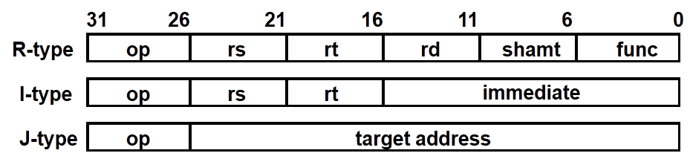
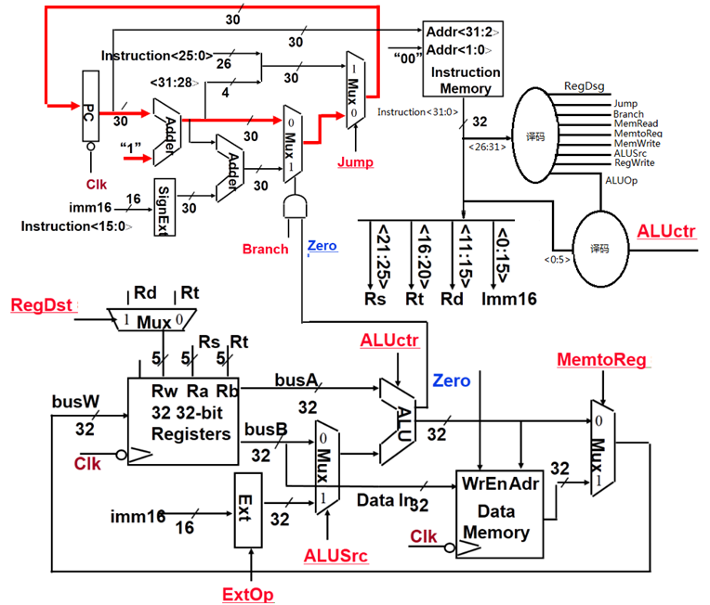

Slide 63
ALU的设计-实现11条MIPS指令的ALU
教材中给出的ALU实现了11条指令的运算功能，如下表所示：
指令
add
sub
subu
ori
lw
sw
beq
jump
addiu
slt
sltu
运算
add
sub
subu
or
addu
addu
subu
x
addu
slt
sltu
ALU共有7种不同的运算功能，故需要3位选择信号ALUctr[2:0]。
add：有溢出判断的加法
sub：有溢出判断的减法
addu：无溢出判断的加法，即加法器的溢出标志位不输出。
subu：无溢出判断的减法，即加法器的溢出标志位不输出。
or：按位逻辑或运算
slt：带符号数的大小比较，用两数相减的符合和溢出标志来判断。
sltu：无符号数的大小比较，用两数相减的借位标志来判断。
ALU中最核心的是加法器，加上各种逻辑电路可实现减法、无溢出判断的加减法、逻辑运算or以及“小于则置1” 等运算操作。
ALU各种运算功能是通过输入不同的ALUctr产生相应的逻辑电路控制信号，让加法器和外围逻辑电路实现指定的运算功能。因此ALU中需要一个控制信号产生逻辑。

Slide 64
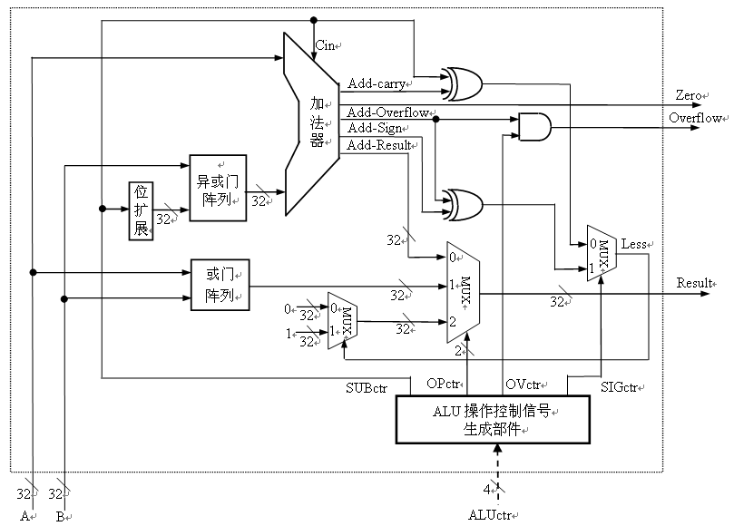
ALU的设计-实现11条MIPS指令的ALU（教材P. 155 图5.13）
ALUctr=add/sub时, OVctr=1
ALUctr=其余运算时, OVctr=0
溢出控制
ALUctr=sltu, SIGctr=0
ALUctr=slt, SIGctr=1
其余情况，任意
比较控制
ALUctr=sub/subu/slt/sltu时, SUBctr=1，其余 SUBctr=0
减法控制
控制信号SUBctr、Opctr、Ovctr和SIGctr由ALUctr产生
做减法以比较大小，规则：
Unsigned: CF=0时，大于
Signed：OF=SF时，大于
3
定点整数ALU！
Notes:
该ALU是定点整数运算器！
算术运算：无符号加、无符号减、带符号数加、带符号数减（原码加/减和移码加减运算电路在浮点运算器中）
按位运算：或
比较运算：小于置1
标志：ZF和OF
定点乘除运算是否也能实现？

Slide 65
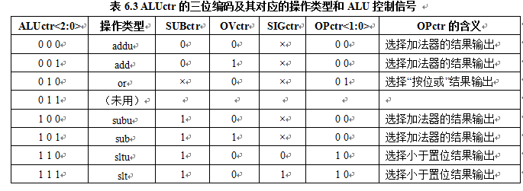
ALUctr与ALU内部控制信号的关系
5
7条指令系统中未用
根据上表可写出ALU操作控制信号的逻辑：
SUBctr = ALUctr<2>
OVctr = !ALUctr<1>&ALUctr<0>
SIGctr = ALUctr<0> 7条指令系统中不用
OPctr<1> = ALUctr<2> & ALUctr<1>
OPctr<0> = !ALUctr<2> & ALUctr<1> & !ALUctr<0>
参考

Slide 66
综合分析结果，得到指令与控制信号的关系表
func
10 0000
10 0010
与func字段无关！
op
00 0000
00 0000
00 1101
10 0011
10 1011
00 0100
00 0010
控制信号
指令
add
sub
ori
lw
sw
beq
jump
RegDst
1
1
0
0
x
x
x
ALUSrc
0
0
1
1
1
0
x
MemtoReg
0
0
0
1
x
x
x
RegWrite
1
1
1
1
0
0
0
MemWrite
0
0
0
0
1
0
0
Branch
0
0
0
0
0
1
0
Jump
0
0
0
0
0
0
1
ExtOp
x
x
0
1
1
x
x
ALUctr<2:0>
add
sub
or
addu
addu
subu
xxx
31
26
21
16
11
6
0
R-type
op
rs
rt
rd
shamt
func
add, sub
I-type
op
rs
rt
immediate
ori, lw, sw, beq
J-type
op
target address
jump
Notes:
Here is a table summarizing the control signals setting for the seven (add, sub, ...) instructions we have looked at.
Instead of showing you the exact bit values for the ALU control (ALUctr), I have used the symbolic values here.
The first two columns are unique in the sense that they are R-type instrucions and in order to uniquely identify them, we need to look at BOTH the op field as well as the func fiels.
Ori, lw, sw, and branch on equal are I-type instructions and Jump is J-type. They all can be uniquely idetified by looking at the opcode field alone.
Now let’s take a more careful look at the first two columns. Notice that they are identical except the last row.
So we can combine these two rows here if we can “delay” the generation of ALUctr signals.
This lead us to something called “local decoding.”
+3 = 42 min. (Y:22)

Slide 67
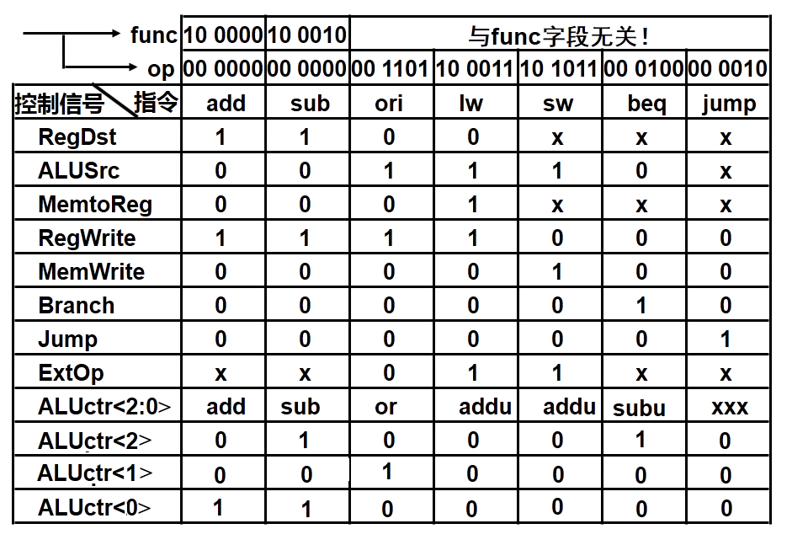
Main Control 的译码逻辑, ALU局部控制器的译码逻辑
assign ALUctr<2>=
(op==6’b000000)
&& (function=6’b100010)
|| (function==6’b000100)
assign ALUctr<1>=
(op==6’b000000)
&& (function=6’b001101)
assign ALUctr<0>=
(op==6’b000000)
&& (function==6’b100000)
|| (function==6’b100010)
Verilog设计控制器的逻辑
布尔式RegDst = !op5 & !op4 & !op3 & !op2 & !op1 & !op0
assign RegDst=(op==6’b000000)
assign ALUSrc=(op==6’b00 1101) || (op==6’b10 0011) || (op==6’b10 1011)
assign MemtoReg=(op==6’b10 0011)
assign RegWrite=(op==6’b000000) || (op==6’b00 1101) || (op==6’b10 0011)
assign MemWrite=(op==6’b10 1011)
assign Branch=(op==6’b00 0100)
assign Jump=(op==6’b00 0010)
assign ExtOp=(op==6’b10 0011) || (op==6’b10 1011)
Notes:
Here is a table summarizing the control signals setting for the seven (add, sub, ...) instructions we have looked at.
Instead of showing you the exact bit values for the ALU control (ALUctr), I have used the symbolic values here.
The first two columns are unique in the sense that they are R-type instrucions and in order to uniquely identify them, we need to look at BOTH the op field as well as the func fiels.
Ori, lw, sw, and branch on equal are I-type instructions and Jump is J-type. They all can be uniquely idetified by looking at the opcode field alone.
Now let’s take a more careful look at the first two columns. Notice that they are identical except the last row.
So we can combine these two rows here if we can “delay” the generation of ALUctr signals.
This lead us to something called “local decoding.”
+3 = 42 min. (Y:22)

Slide 68
主控制单元和ALU局部控制单元
教材中给出的布尔逻辑设计方法
MIPS指令格式中指示操作性质的字段有两个：op(主控) 和 func（ALU局控）。
op
00 0000
00 1101
10 0011
10 1011
00 0100
00 0010
控制信号
指令
R-type
ori
lw
sw
beq
jump
RegDst
1
0
0
x
x
x
ALUSrc
0
1
1
1
0
x
MemtoReg
0
0
1
x
x
x
RegWrite
1
1
1
0
0
0
MemWrite
0
0
0
1
0
0
Branch
0
0
0
0
1
0
Jump
0
0
0
0
0
1
ExtOp
x
0
1
1
x
x
ALUctr
Add/Sub
Or
Addu
Addu
Subu
xxx
func
ALU
Control
(Local)
ALUctr的值：
对于非R型指令，等于ALUop;
对于R型指令，
取决于func。
op
6
1
ALUctr
3
Main
Control
3
6
ALUop
N=?
0
R-Type
ALU
ALUctr有5种操作，需3位，ALUop应与其长度一致，故N为3！
Notes:
That is, instead of asking the Main Control to generates the ALUctr signals directly (see the diagram with the ALU), the main control will generate a set of signals called ALUop.
For all I and J type instructions, ALUop will tell the ALU Control exactly what the ALU needs to do (Add, Subtract, ...) .
But whenever the Main Control sees a R-type instructions, it simply throws its hands up and say: “Wow, I don’t know what the ALU has to do but I know it is a R-type instruction” and let the Local Control Block, ALU Control to take care of the rest.
Notice that this save us one column from the table we had on the last slide. But let’s be honest, if one column is the ONLY thing we save, we probably will not do it.
But when you have to design for the entire MIPS instruction set, this column will used for ALL R-type instructions, which is more than just Add and Subtract I showed you here.
Another advantage of this table over the last one, besides being smaller, is that we can uniquely identify each column by looking at the Op field only.
Therefore, as I will show you later, the Main Control ONLY needs to look at the Opcode field.
How many bits do we need for ALUop?
+3 = 45 min. (Y:25)

Slide 69
ALUop的逻辑表达式
func
ALU
Control
(Local)
op
6
1
ALUctr
Main
Control
6
ALUop
3
0
R-Type
ALUop的编码定义如下：
参考
指令
R-type
ori
lw
sw
beq
jump
运算
由func指定
or
addu
addu
subu
x
ALUop<2:0>
xxx
010
000
000
100
xxx
ALUop是用于非R型指令产生ALUctr，因此与R型指令无关。
Jump指令的执行不使用ALU，故与ALUop无关。
R型指令所需ALUctr与func有关，它们在局部控制器中产生。
ALUop<0>=0
ALUop<1>=ori
ALUop<2>=beq
Notes:
What this table and diagram implies is that if the ALU Control receives ALUop = 100, it has to decode the instruction’s “func” field to figure out what the ALU needs to do.
Based on the MIPS encoding in Appendix A of your text book, we know we have a Add instruction if the func field is 10 000.
If the func field is 10 0010, we know we have a subtract operation and so on.
Notice that the bit 5 and bit 4 of this field is the same for all these operations so as far as the ALU control is concerned, these bits are don’t care.
Now recall from your ALU homework, the ALUctr signals has the following meaning (point to the table): 000 means Add, 001 means subtract, ... etc.
Based on these three tables (point to the last row of the top table and then the two other tables) and the fact that bit 5 and bit 4 of the “func” field are don’t care, we can derive the following truth table for ALUctr.
+2 = 48 min. (Y:28)

Slide 70
ALU局部控制器逻辑表达式
func
ALU
Control
(Local)
ALUctr
op
6
3
1
Main
Control
6
ALUop
3
0
R-Type
3
ALU
31
26
21
16
11
6
0
R-type
000000
rs
rt
rd
shamt
func
func<5:0>
指令
ALUctr<2:0>
ALU Operation
10 0000
add
001
add
10 0010
sub
101
sub
由于7条指令系统中只有add和sub两条R型指令，局部控制器逻辑就很简单
ALUctr<0> = 1
ALUctr<1> = 0
ALUctr<2> = func<1>
Notes:
From the truth table we had before the break, we can derive the logic equation for ALUctr bit 2 by collecting all the rows that has ALUCtr bit 2 equals to 1 and this table is the result.
Each row becomes a product term and we need to OR the product terms together.
Notice that the last row are identical except the bit<3> of the func fields. One is zero and the other is one. Together, they make bit<3> a don’t care term.
With all these don’t care terms, the logic equation is rather simple.
The first product term is: not ALUOp<2> and ALUOp<0>.
The second product term, after we making Func<3> a don’t care becomes ...
+2 = 57 min. (Y:37)

Slide 71
主控制单元的真值表
func
RegDst
6
ALU
Control
(Local)
ALUSrc
1
ALUctr
op
Main
Control
:
ALUop
0
3
6
3
R-Type
主控单元的输入
主控单元的输出
op
00 0000
00 1101
10 0011
10 1011
00 0100
00 0010
R-type
ori
lw
sw
beq
jump
RegDst
1
0
0
x
x
x
ALUSrc
0
1
1
1
0
x
MemtoReg
0
0
1
x
x
x
RegWrite
1
1
1
0
0
0
MemWrite
0
0
0
1
0
0
Branch
0
0
0
0
1
0
Jump
0
0
0
0
0
1
ExtOp
x
0
1
1
x
x
ALU运算
“R-type”
Or
Addu
Addu
Subu
xxx
BACK
ALUop <2>
x
0
0
0
1
x
ALUop <1>
x
1
0
0
0
x
ALUop <0>
x
0
0
0
0
x
R-type
1
0
0
0
0
0
Notes:
Now that we have taken care of the Local Control (ALU Control), let’s refocus our attention to the Mian Controller.
The job of the Main Control is to look at the Opcode field of the instruction and generate these control signals for the datapath (RegDst, ... ExtOp) as well as the 3-bit ALUop field for the ALU Control.
Here, I have shown you the symbolic value of the ALUop field as well as the actual bit assignment.
For example here (2nd column), the R-type ALUop is encode as 100 and the Add operation (3rd column) is encoded as 000..
This is call a quote “Truth Table” unquote because if you think about it, this is like having the truth table rotates 90 degrees.
Let me show you what I mean by that.
+3 = 65 min. (Y:45)

Slide 72
考察每个控制信号的逻辑方程（如：RegWrite）
op
00 0000
00 1101
10 0011
10 1011
00 0100
00 0010
R-type
ori
lw
sw
beq
jump
RegWrite
1
1
1
0
0
0
RegWrite = R-type + ori + lw
  = !op<5> & !op<4> & !op<3> & !op<2> & !op<1> & !op<0> (R-type)
  + !op<5> & !op<4> & op<3> & op<2> & !op<1> & op<0> (ori)
  + op<5> & !op<4> & !op<3> & !op<2> & op<1> & op<0> (lw)
.
.
.
.
.
.
op<5>
op<5>
op<5>
op<5>
op<5>
op<5>
.
.
.
.
.
.
<0>
<0>
<0>
<0>
<0>
op<0>
指令译码器
R-type
ori
lw
sw
beq
jump
RegWrite
Notes:
For example, consider the control signal RegWrite.
If we treat all the don’t cares as zeros, this row here means RegDest has to be equal to one whenever we have a R-type, or an OR immediate, or a load instruction.
Since we can determine whether we have any of these instructions (point to the column headers) by looking at the bits in the “OP” field, we can transform this symbolic equation to this binary logic equation.
For example, the first product term here say we have a R-type instruction whenever all the bits in the “OP” field are zeros.
So each of these big AND gates implements one of the columns (R-type, ori, ...) in our table. Or in more technical terms, each AND gate implements a product term.
In order to finish implementing this logic equation, we have to OR the proper terms together.
In the case of the RegWrite signal, we need to OR the R-type, ORi, and load terms together.
+2 = 67 min. (Y:47)

Slide 73
Main Control的PLA实现
.
.
.
.
.
.
op<5>
op<5>
op<5>
op<5>
op<5>
op<5>
.
.
.
.
.
.
<0>
<0>
<0>
<0>
<0>
op<0>
指令译码器
参考
R-type
ori
lw
sw
beq
jump
RegWrite
ALUSrc
RegDst
MemtoReg
MemWrite
Branch
Jump
ExtOp
‘0’
ALUop<0>
ALUop<1>
ALUop<2>
R-Type
Notes:
Similarly, for ALUSrc, we need to OR the ori, load, and store terms together because we need to assert the ALUSrc signals whenever we have the Ori, load, or store instructions.
The RegDst, MemtoReg, MemWrite, Branch, and Jump signals are very simple. They don’t need to OR any product terms together because each is asserted for only one instruction.
For example, RegDst is asserted ONLY for R-type instruction and MemtoReg is asserted ONLY for load instruction.
ExtOp, on the other hand, needs to be set to 1 for both the load and store instructions so the immediate field is sign extended properly.
Therefore, we need to OR the load and store terms together to form the signal ExtOp.
Finally, we have the ALUop signals.
But clever encoding of the ALUop field, we are able to keep them simple so that no OR gates is needed.
If you don’t already know, this regular structure with an array of AND gates followed by another array of OR gates is called a Programmable Logic Array, or PLA for short.
It is one of the most common ways to implement logic function and there are a lot of CAD tools available to simplify them.
+3 = 70 min. (Y:50)

Slide 74
执行前述7条指令的完整的单周期处理器
ALUop
3
ALU
Control
ALUctr
RegDst
func
op
Main
Control
3
ALUSrc
Instr<5:0>
6
6
:
Instr<31:26>
R-Type
Branch
Instruction<31:0>
Rd
Rt
Instruction
Fetch Unit
Jump
RegDst
<21:25>
<16:20>
<0:15>
1
0
Clk
<11:15>
Mux
RegWr
Rs
Rt
Rt
Rs
Rd
Imm16
ALUctr
5
5
5
MemtoReg
busA
Zero
Rw
Ra
Rb
Overflow
busW
32
32 32-bit
Registers
0
32
busB
ALU
32
0
MemWr
Clk
32
Mux
Mux
32
32
WrEn
Adr
1
1
Data In
imm16
Ext
32
Data
Memory
Instr<15:0>
16
Clk
ALUSrc
ExtOp
Notes:
OK, now that we have the Main Control implemented, we have everything we needed for the single cycle processor and here it is.
The Instruction Fetch Unit gives us the instruction. The OP field is fed to the Main Control for decode and the Func field is fed to the ALU Control for local decoding.
The Rt, Rs, Rd, and Imm16 fields of the instruction are fed to the data path.
Based on the OP field of the instruction, the Main Control will set the control signals RegDst, ALUSrc, .... etc properly as I showed you earlier using separate slides.
Furthermore, the ALUctr use the ALUop from the Main control and the func field of the instruction to generate the ALUctr signals to ask the ALU to do the right thing: Add, Subtract, Or, and so on.
This processor will execute each of the MIPS instruction in the subset in one cycle.
There is, however, a couple of subtle differences between this single-cycle processor and a real MIPS processor in terms of instruction execution.
+2 = 72 min (Y:52)

Slide 75
lw指令的执行时间最长, 它所花时间作为时钟周期
Clk
PC+4 PC
Clk-to-Q
PC
Old Value
New Value
建立时间
PC+4
Instruction Memory Access Time
Rs, Rt, Rd,
Op, Func
Old Value
New Value
Delay through Control Logic
ALUctr
Old Value
New Value
ExtOp
Old Value
New Value
ALUSrc
Old Value
New Value
MemtoReg
Old Value
New Value
Register
Write Occurs
RegWr
Old Value
New Value
Register File Access Time
busA
Old Value
New Value
Delay through Extender & Mux
busB
Old Value
New Value
ALU Delay
Address
Old Value
New Value
Data Memory Access Time
busW
Old Value
New
Notes:
This timing diagram shows the worst case timing of our single cycle datapath which occurs at the load instruction.
Clock to Q time after the clock tick, PC will present its new value to the Instruction memory.
After a delay of instruction access time, the instruction bus (Rs, Rt, ...) becomes valid.
Then three things happens in parallel:
(a) First the Control generates the control signals (Delay through Control Logic).
(b) Secondly, the register file access is to put Rs onto busA.
(c) And we have to sign extended the immediate field to get the second operand (busB).
Here I assume register file access takes longer time than doing the sign extension so we have to wait until busA valid before the ALU can start the address calculation (ALU delay).
With the address ready, we access the data memory and after a delay of the Data Memory Access time, busW will be valid.
And by this time, the control unit would have set the RegWr signal to one so at the next clock tick, we will write the new data coming from memory (busW) into the register file.
+3 = 77 min. (Y:57)

Slide 76
单周期计算机的性能
CPI=1!
单周期处理器的CPI为多少？
  其他条件一定的情况下，CPI越小，则性能越好！
单周期处理器的性能会不会很好？为什么？
  计算机的性能除CPI外，还取决于时钟周期的宽度。
  单周期处理器的时钟宽度为最复杂指令的执行时间。
  很多指令可以在更短的时间内完成，但都花同样的时间。

Slide 77
单周期计算机的性能分析例子
假设在单周期处理器中，各主要功能单元的操作时间为：
存储单元：200ps
ALU和加法器：100ps
寄存器堆（读/写）：50ps
假设MUX、控制单元、PC、扩展器和传输线路都没有延迟，则下面实现方式中，哪个更快？快多少？
（1）每条指令在一个固定长度的时钟周期内完成
（2）每条指令在一个时钟周期内完成，但时钟宽度按指令所需调整，也即为可变的（实际不可行，只是为了比较）
假设程序中各类指令占比：25%取数、10%存数、45%ALU、15%分支、5%跳转

Slide 78
单周期计算机的性能
解：CPU执行时间=指令条数 x CPI x 时钟周期=指令条数 x 时钟周期
两种方案的指令条数都一样，CPI都为1，所以只要比较时钟周期宽度即可。
各类指令要求的时间长度为：

Slide 79
单周期计算机的性能
对于方式（1），时钟周期由最长指令来决定，应该是load指令，为600ps
对于方式（2），时钟周期取各条指令所需时间，时钟周期从600ps至200ps
根据各类指令的频度，计算出平均时钟周期长度为：
CPU时钟周期=600x25%+550x10%+400x45%+350x15%+200x5%=447.5ps
CPU性能比= = = =1.34
方式(1)的CPU执行时间
方式(1)的CPU 时钟周期
600
方式(2)的CPU执行时间
方式(2)的CPU 时钟周期
447.5
由此可见，可变时钟周期的性能是定长周期的1.34倍！
但是，对每类指令采用可变长时钟周期实现非常困难，而且所带来的额外开销会很大，不合算！
早期的小指令集计算机用过单周期实现技术，但现代计算机都不采用。
多周期数据通路和控制器就是用于解决上述问题的方案，其特点是：
时钟周期固定、时钟周期数可变

Slide 80
第二讲 小结
考察每条指令在单周期数据通路中的执行过程
  每条指令在一个时钟周期内完成
  每个时钟到来时，都开始进入取指令操作
    经过clk-to-Q，PC得到新值，经过access time后得到当前指令
    按三种方式分别计算下条指令地址，在branch / zero / jump的控制下，选择其中之一送到PC输入端，但不会马上写到PC中，一直到下个时钟到达时，才会更新PC。三种下址方式为：
      branch=jump=0：PC+4
      branch=zero=1： PC+4+signExt[imm16]*4
      jump=1： PC<31:28> concat target<25:0> concat “00”
  指令取出后被译码，产生指令对应的控制信号
    R-type指令：rd为目的寄存器，无访存操作，……
    ori指令：rt为目的寄存器，0扩展，无访存操作，……
    lw指令： rt为目的寄存器，计算地址、符号扩展，读内存，……
    sw指令： rt为源寄存器，计算地址、符号扩展，写内存，……
汇总每条指令控制信号的取值，生成真值表，写出逻辑表达式，设计主控制逻辑和ALU局部控制逻辑

Slide 81
第三讲 微程序设计和异常处理
主 要 内 容
硬连线控制器设计的优点和缺点
微程序控制器的基本思想
微程序、微指令、微操作和微命令的概念及其关系
微指令格式设计
  微操作码字段
    水平微程序：不译法、字段直接编译法、字段间接编译法
    垂直微程序：垂直编译法
  下条微指令地址确定方式
    增量法（计数器法）
    断定法（下址字段法）
MIPS指令子集的微程序控制器设计

Slide 82
硬连线控制器和微程序控制器
硬连线控制器的特点：
优点：速度快，适合于简单或规整的指令系统，例如，MIPS指令集。
缺点：它是一个多输入/多输出的巨大逻辑网络。对于复杂指令系统来说，结构庞杂，实现困难；修改、维护不易；灵活性差。甚至无法用有限状态机描述！
简化控制器设计的一个方法：微程序设计
微程序控制器的基本思想：
  仿照程序设计的方法，编制每条指令对应的微程序
  每个微程序由若干条微指令构成，各微指令包含若干条微命令
  所有指令对应的微程序放在只读存储器中，执行某条指令就是取出对应微程序中的各条微指令，对微指令译码产生对应的微命令(即控制信号)。
  这个只读存储器称为控制存储器（Control Storage），简称控存CS 。
微程序设计的特点：具有规整性、可维护性和灵活性，但速度慢。

Slide 83
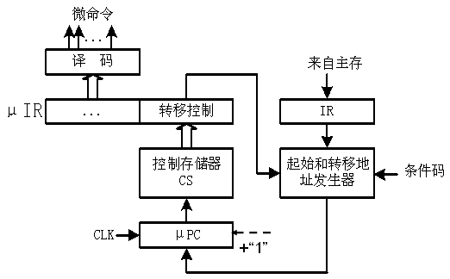
微程序控制器的基本结构
指令
输入：指令、条件码
输出：控制信号(微命令)
核心：控存CS
µPC：指出将要执行的微指令在CS中的位置
µIR： 正在执行的微指令
每个时钟执行一条微指令
微程序第一条微指令地址由起始地址发生器产生
顺序执行时， µPC+1
转移执行时，由转移控制字段指出对哪些条件码进行测试，转移地址发生器根据条件码修改µPC
最初把固化在ROM的微程序称固件（Firmware），表示用软件实现的硬部件，现在对固件通俗的理解是在ROM中“固化的软件”。

Slide 84


微程序\微指令\微命令\微操作的关系
将指令的执行转换为微程序的执行
微程序是一个微指令序列
每条微指令是一个0/1序列，其中包含若干个微命令（即：控制信号）
微命令控制数据通路的执行
一条机器指令
一般程序执行要解决什么问题？
(1) 指令如何译码、执行
(2) 下条指令到哪里去取
微程序执行也要解决两个问题：
(1)微指令如何对微命令编码
(2)下条微指令在哪里
一个微程序
微指令1
微指令2
微指令n
微命令1
微命令2
微命令m
微操作
微操作
微操作

Slide 85
第一个问题：微指令格式的设计
水平型微指令
基本思想：相容微命令尽量多地安排在一条微指令中。
优点：微程序短，并行性高，适合于较高速度的场合。
缺点：微指令长，编码空间利用率较低，并且编制困难。
垂直型微指令
基本思想：一条微指令只控制一、二个微命令。
优点：微指令短，编码效率高，格式与机器指令类似，故编制容易。
缺点：微程序长，一条微指令只能控制一、二个操作，无并行，速度慢
垂直型微指令面向算法描述，水平型微指令面向内部控制逻辑描述

Slide 86
第一个问题：微指令格式的设计
微指令中包含了：若干微命令、下条微指令地址（可选）、常数（可选）
微指令格式：
常数
µOP
µAddr
µOP: 微操作码字段，产生微命令；
µAddr：微地址码字段，产生下条微指令地址。
微指令格式设计风格取决于微操作码的编码方式
微操作码编码方式：
  不译法（直接控制法）
  字段直接编码（译）法
  字段间接编码（译）法
  最小（最短、垂直）编码（译）法
水平型微指令风格
垂直型微指令风格

Slide 87
7条指令的完整的单周期处理器
ALUop
3
ALU
Control
ALUctr
RegDst
func
op
Main
Control
3
ALUSrc
Instr<5:0>
6
6
:
Instr<31:26>
R-Type
Branch
Instruction<31:0>
Rd
Rt
Instruction
Fetch Unit
Jump
RegDst
<21:25>
<16:20>
<0:15>
1
0
Clk
<11:15>
Mux
RegWr
Rs
Rt
Rt
Rs
Rd
Imm16
ALUctr
5
5
5
MemtoReg
busA
Zero
Rw
Ra
Rb
Overflow
busW
32
32 32-bit
Registers
0
32
busB
ALU
32
0
MemWr
Clk
32
Mux
Mux
32
32
WrEn
Adr
1
1
Data In
imm16
Ext
32
Data
Memory
Instr<15:0>
16
Clk
ALUSrc
ExtOp
Notes:
OK, now that we have the Main Control implemented, we have everything we needed for the single cycle processor and here it is.
The Instruction Fetch Unit gives us the instruction. The OP field is fed to the Main Control for decode and the Func field is fed to the ALU Control for local decoding.
The Rt, Rs, Rd, and Imm16 fields of the instruction are fed to the data path.
Based on the OP field of the instruction, the Main Control will set the control signals RegDst, ALUSrc, .... etc properly as I showed you earlier using separate slides.
Furthermore, the ALUctr use the ALUop from the Main control and the func field of the instruction to generate the ALUctr signals to ask the ALU to do the right thing: Add, Subtract, Or, and so on.
This processor will execute each of the MIPS instruction in the subset in one cycle.
There is, however, a couple of subtle differences between this single-cycle processor and a real MIPS processor in terms of instruction execution.
+2 = 72 min (Y:52)

Slide 88
主控制单元的真值表
func
RegDst
6
ALU
Control
(Local)
ALUSrc
1
ALUctr
op
Main
Control
:
ALUop
0
3
6
3
R-Type
主控单元的输入
主控单元的输出
op
00 0000
00 1101
10 0011
10 1011
00 0100
00 0010
R-type
ori
lw
sw
beq
jump
RegDst
1
0
0
x
x
x
ALUSrc
0
1
1
1
0
x
MemtoReg
0
0
1
x
x
x
RegWrite
1
1
1
0
0
0
MemWrite
0
0
0
1
0
0
Branch
0
0
0
0
1
0
Jump
0
0
0
0
0
1
ExtOp
x
0
1
1
x
x
ALU运算
“R-type”
Or
Addu
Addu
Subu
xxx
BACK
ALUop <2>
x
0
0
0
1
x
ALUop <1>
x
1
0
0
0
x
ALUop <0>
x
0
0
0
0
x
R-type
1
0
0
0
0
0
Notes:
Now that we have taken care of the Local Control (ALU Control), let’s refocus our attention to the Mian Controller.
The job of the Main Control is to look at the Opcode field of the instruction and generate these control signals for the datapath (RegDst, ... ExtOp) as well as the 3-bit ALUop field for the ALU Control.
Here, I have shown you the symbolic value of the ALUop field as well as the actual bit assignment.
For example here (2nd column), the R-type ALUop is encode as 100 and the Add operation (3rd column) is encoded as 000..
This is call a quote “Truth Table” unquote because if you think about it, this is like having the truth table rotates 90 degrees.
Let me show you what I mean by that.
+3 = 65 min. (Y:45)

Slide 89
举例：单周期数据通路对应的微操作码
11
0
Jump
ExtOp
ALUop 2
ALUop 0
RegDst
ALUSrc
MemtoReg
RegWrite
MemWrite
Branch
ALUop 1
R-type
控制字 (微指令) 长度等于
控制信号（微命令）总位数
Add/sub
00 0000
100100000001
jump
00 0010
000000100000
beq
00 0100
000001001000
采用不译法的微操作码格式为：
ori
00 1101
010100000100
lw
10 0011
011100010000
该图对应控制器的微指令长度为多少位？
sw
10 1011
010010010000
Notes:
Because in this next cycle, the Write Back cycle, we will write the data from memory (MemtoReg = 1) into the register specified by the Rt field of the instruction.
+1 = 66 min. (Y:46)

Slide 90
第二个问题：下条微地址的确定方式
微程序执行顺序的控制问题
  在现行微指令执行完毕后，怎样控制产生下一条微指令的地址。
怎样控制微程序的执行顺序？
  通过在本条微指令中明显或隐含地指定下条微指令在控存中的地址来控制。
微指令地址的产生方法有两种：
  增量(计数器)法：下条微指令地址隐含在微程序计数器μPC中。
  断定(下址字段)法：在本条微指令中明显指定下条微指令地址。
选择下条要执行的微指令有以下四种情况：
  取指微程序首址：每条指令执行前，CPU先执行取指微程序。
  第一条微指令：每条指令取出后，必须转移到该指令对应的第一条微指令执行。
  顺序执行时：微程序执行过程中顺序取出下条微指令执行。
  分支执行时：在遇到按条件转移到不同微指令执行时，需要根据控制单元的输入来选择下条微指令。
问题：机器指令是隐含还是明显指出下条指令地址的？

Slide 91
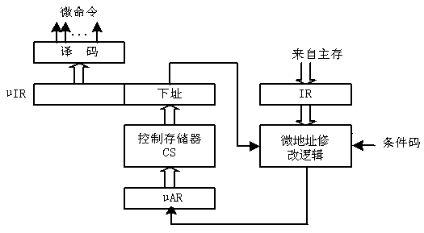
不同微地址产生方法对应的控制器结构
指令
指令
转移
控制
增量（计数器）法 断定（下址字段）法
  增量(计数器)法：下条微指令地址隐含在微程序计数器μPC中。
  断定(下址字段)法：在本条微指令中明显指定下条微指令地址。

Slide 92
本讲小结
硬连线控制器的优点是速度快，适合于简单规整指令集的数据通路；缺点是设计周期长、繁琐、不灵活、不易修改和增删指令
微程序控制器借用程序设计思想，将每个周期所涉及的状态用只读存储器保存起来，执行到某条指令时，把这条指令对应的状态按序取出，转换为控制信号。优点：简化设计、灵活、易修改、易维护；缺点：速度慢。

Slide 93
第五讲 异常和中断处理
主 要 内 容
为什么处理器设计要考虑异常的处理
“异常”和“中断”的概念
如何在数据通路中加入异常处理部件
如何控制数据通路中的异常处理部件

Slide 94
异常和中断的处理
程序执行过程中CPU会遇到一些特殊情况，使正在执行的程序被“中断”
  此时，CPU中止原来正在执行的程序，转到处理异常情况或特殊事件的程序去执行，执行后再返回到原被中止的程序处（断点）继续执行。
程序执行被 “中断” 的事件有两类
  内部“异常”：在CPU内部发生的意外事件或特殊事件
    按发生原因分为硬故障中断和程序性中断两类
    硬故障中断：如电源掉电、硬件线路故障等
    程序性中断：执行某条指令时发生的“例外(Exception)”，如溢出、缺页、越界、越权、非法指令、除数为0、堆栈溢出、访问超时、断点设置、单步、系统调用等.
  外部“中断”：在CPU外部发生的特殊事件，通过“中断请求”信号向CPU请求处理。如实时钟、控制台、打印机缺纸、外设准备好、采样计时到、DMA传输结束等。
    (外部中断是一种I/O方式，所以有关外部中断的概念在第8章介绍。)
Notes:
一种情况：上课时由于机器死机（PPT不能放）或屏幕保护（黑屏）等，使上课不能再正常继续下去----“内部异常”
另一种情况：上课时突然有紧急事情需要上课老师出去处理一下，回头继续上课----“外部中断”
打铃下课是“内部异常”还是“外部中断”？

Slide 95
异常和中断的处理
内部“异常” 按处理方式分为故障、自陷和终止三类
  故障(fault) ：执行指令引起的异常事件，如溢出、缺页、堆栈溢出、访问超时等。
  自陷(Trap) ：预先安排的事件，如单步跟踪、系统调用(执行访管指令)等。是一种自愿中断。
  终止(Abort) ：硬故障事件，此时机器将“终止”，调出中断服务程序来重启操作系统。
“断点”为发生故障指令的地址
“断点”为发生下条指令的地址
“断点”是什么？ 随便！
  思考1：自陷处理完成后回到哪条指令执行？
回到下条指令！
  思考2：哪些故障补救后可继续执行，哪些只好终止当前进程？
  缺页、TLB缺失等：补救后可继续，回到发生故障的指令重新执行；
  溢出、除数为0、非法操作、内存保护错等：终止当前进程。
不同体系结构和教科书对“异常”和“中断”定义的内涵不同，在看书时要注意！

Slide 96
处理器中的异常处理机制
检测到异常时，处理器必须进行以下基本处理：
① 关中断（“中断/异常允许”状态位清0）：使处理器处于“禁止中断”状态，以防止新异常(或中断)破坏断点、程序状态和现场（现场指通用寄存器的值）。
② 保护断点和程序状态：将断点和程序状态保存到堆栈或特殊寄存器中。即：
  PC→堆栈 或 EPC（专门存放断点的寄存器）
  PSWR →堆栈 或 EPSWR （专门保存程序状态的寄存器）
  PSW（Program Status Word）：程序状态字，包括条件码、中断码、状态位等。
  PSWR（PSW寄存器）：用于存放程序状态字的寄存器。如，X86的FLAGS）。
③ 识别异常事件：有软件识别和硬件识别（向量中断方式）两种不同的方式。

Slide 97
处理器中的异常处理机制
有两种不同的识别方式：软件识别和硬件识别（向量中断方式）。
（1）软件识别（MIPS采用）
设置一个异常状态寄存器（MIPS中为Cause寄存器），用于记录异常原因。操作系统使用一个统一的异常处理程序，该程序按优先级顺序查询异常状态寄存器的各位，识别出异常事件。
（例如：MIPS中位于内核地址0x8000 0180处有一个专门的异常处理程序，用于检测异常的具体原因，然后转到内核中相应的异常处理程序段中进行具体的处理）
（2）硬件识别（向量中断）（80x86采用）
用专门的硬件查询电路按优先级顺序识别异常，得到“中断类型号”，根据此号，到中断向量表中读取对应的中断服务程序的入口地址。

Slide 98
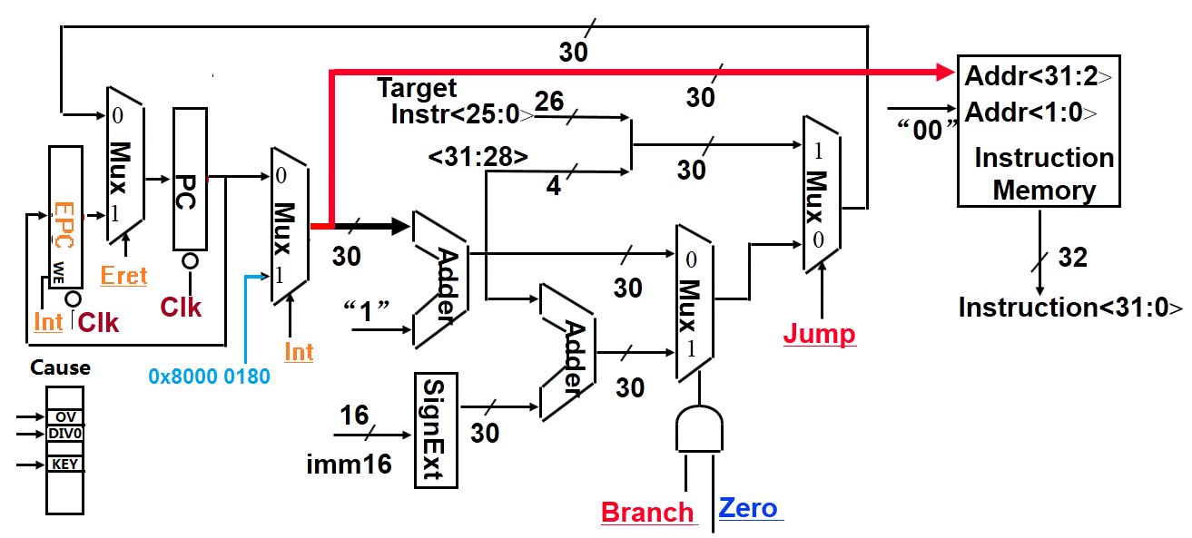
MIPS带异常处理的数据通路设计
MIPS采用软件（操作系统提供的一个特定的异常查询程序）识别中断源
数据通路中需增加以下两个寄存器：
  EPC：32位，用于存放断点（异常处理后返回到的指令的地址）。
  Cause：32位（有些位还没有用到），记录异常原因。
    假定处理的异常类型有以下两种：
      未定义指令（Cause=0）、溢出（Cause=1）
需要将异常查询程序的入口地址（MIPS为0x8000 0180）

Slide 99
MIPS中断系统
中断请求: CPU每条指令指令结束时，检查是否有中断请求，即:判断ISR是否为1?(硬件完成)
CPU响应: 如果有中断请求，即ISR=1，则保存断点(PC），并转到中断服务程序。(硬件完成)
    EPC←PC
    PC← 0x8000 0180
中断处理: 中断服务程序，软件
中断返回: 中断服务程序结束时，在最后安排一条中断返回指令eret。
eret 指令: PC←EPC

Slide 100
8086/8088中断系统（采用向量中断方式）
中断：内中断（内部异常）和外中断（外部中断）
内中断：CPU自己产生而不通过中断请求线请求，皆为不可屏蔽中断。
  中断指令引起的异常：CPU执行预置的指令后在特定的情况下发生的异常。
  INT O 溢出：执行算术指令后，若发生溢出，则产生类型4中断。
  INT n 用户定义：指令的第二字节给出一个类型号(n=0～255)。
  例如，n=3 (INT 3)时为断点设置，该指令执行后，自动产生类型3中断。
  处理器检测异常：CPU执行指令时产生的异常，如：除法错、无效操作码、缺页、单步跟踪调试等。
  例如，除法错：除数为0或商溢出，则产生类型0中断。
外中断：通过中断请求线INTR和NMI来实现。
  INTR：可屏蔽中断 (外设中断源引起的中断)。
  NMI：不可屏蔽中断 (重要或紧急的硬件故障)，属于类型2中断。
所有事件都被分配一个“中断类型号”，每个中断都有相应的“中断服务程序”，可根据中断类型号找到中断服务程序的入口地址

Slide 101
8086/8088的中断向量表
中断向量表也称中断入口地址表（或异常表），位于内存0000H～03FFH，共256组，每组占四个字节 （CS:IP）。向量地址=中断类型号 x 4
例1：除法错的中断类型号
为0，故其向量地址
为：0x4=0
例2：NMI的中断类型号为
2，故其向量地址为：
2x4=8
除法错
CS:IP
000～003H
004～007H
008～00BH
3FC～3FFH
单步
CS:IP
NMI
CS:IP
CS:IP
CS:IP
中断向量表（异常表）中每一项是对应中断服务程序的入口地址，被称为中断向量(Interrupt Vector)。
这是最简单的向量中断方式，用以说明其基本原理，x86的实际情况要复杂得多，后面相关课程会有说明。

Slide 102
本讲小结
异常会改变程序执行流程，所以处理器设计要考虑异常处理
在数据通路中加入异常处理必须考虑：
  保存断点和异常原因，并将控制转到异常处理程序首地址处

Slide 103
本章总结1
CPU的主要功能
  周而复始执行指令
  执行指令过程中，若发现异常情况，则转异常处理
  每个指令结束，查询有没有中断请求，有则响应中断
CPU的内部结构
  由数据通路(Datapath)和控制单元(Control unit)组成
    数据通路中包含组合逻辑单元和存储信息的状态单元
      组合逻辑单元用于对数据进行处理，如：加法器、运算器ALU、扩展器（0扩展或符号扩展）、多路选择器、以及状态单元的读操作线路等。
      状态单元包括触发器、寄存器、寄存器堆、数据/指令存储器等，用于对指令执行的中间状态或最终结果进行保存。
    控制单元对指令进行译码，与指令执行得到的条件码或当前机器的状态、时序信号（时钟）等组合，生成对数据通路进行控制的控制信号

Slide 104
本章总结2
CPU中的寄存器
  用户可见寄存器（用户可使用）
    通用寄存器：用来存放地址或数据，需在指令中明显给出
    专用寄存器：用来存放特定的地址或数据，无需在指令中明显给出
    数据寄存器：专用于保存数据，可以是通用或专用寄存器
    地址寄存器：专用于保存地址，可以是通用或专用寄存器。如：段指针、变址器、基址器、堆栈指针、栈帧指针等。
    标志(条件码)寄存器：部分可见。由CPU根据指令执行结果设定，只能以隐含方式读出其中若干位，用户程序（非内核程序）不能改变
  控制和状态寄存器（用户不可使用）
    程序计数器PC
    指令寄存器IR
    存储器地址寄存器MAR
    存储器缓冲(数据)寄存器 MBR / MDR
    程序状态字寄存器PSWR
    临时寄存器：用于存放指令执行过程中的临时信息
    其他寄存器：如，进程控制块指针、系统堆栈指针、页表指针等

Slide 105
本章总结3
指令执行过程
  取指、译码、取数、运算、存结果、查中断
  指令周期：取出并执行一条指令的时间，由若干个时钟周期组成
  时钟周期：CPU中用于信号同步的信号，是CPU最小的时间单位
数据通路的定时方式
  现代计算机都采用时钟信号进行定时
  一旦时钟有效信号到来，数据通路中的状态单元可以开始写入信息
  如果状态单元每个周期都更新信息，则无需加“写使能”控制信号，否则，需加“写使能”控制信号，以使必要时控制信息写入寄存器
数据通路中信息的流动过程
  每条指令在取指令阶段和指令译码阶段都一样
  每条指令的功能不同，故在数据通路中所经过的部件和路径可能不同
  数据在数据通路中的流动过程由控制信号确定
  控制信号由控制器根据指令代码来生成

Slide 106
本章总结4
单周期处理器的设计
  每条指令都在一个时钟周期内完成
  时钟周期以最长的Load指令所花时间为准
  无需加临时寄存器存放指令执行的中间结果
  在一个周期内同一个功能部件不能重复使用
  控制信号在整个指令执行过程中不变。
微程序控制方式
  每个时钟周期所包含的控制信号的值的组合看成是一个0/1序列，每个控制信号对应一个微命令，控制信号取不同的值，就发出不同的微命令
  若干微命令组合成一个微指令，每条指令所包含的动作就由若干条微指令来完成，每来一个时钟，执行一条微指令
  每条指令对应一个微程序，执行时，先找到对应的第一条微指令，然后按照特定的顺序取出后续的微指令执行
  实现的控制器称为微程序控制器
  存放微程序的只读存储器称为控制存储器，简称控存CS

Slide 107
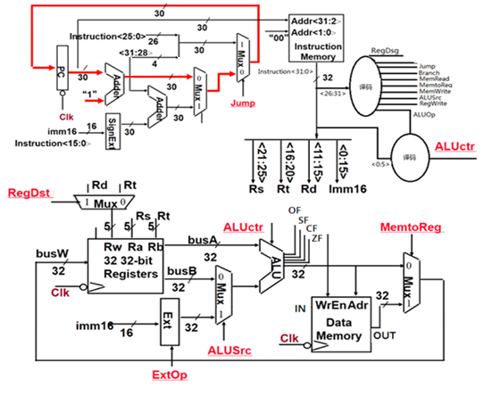
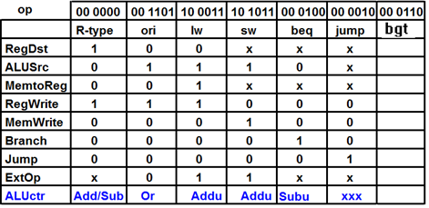
作业：第二版4,6,7，12 第三版3,5,6，4
补充题：
假定MIPS指令系统中有一条I-型指令“bgt Rs, Rt, imm16”,其功能如下：
如Rs>Rt, 则PC=PC+4+imm16*4 否则PC=PC+4.
ALU能产生ZF(零标志)，CF(进位标志)，SF(符号标志)和OF（溢出标志）的输出，
请用图所示的单周期数据通路中增加实现bgt指令的数据通路以及相应的控制信号，并对表增加bgt指令的控制信号取值。

